Slide 1
Lead Service Line Inventory & Replacement
Town of Berlin

Slide 2
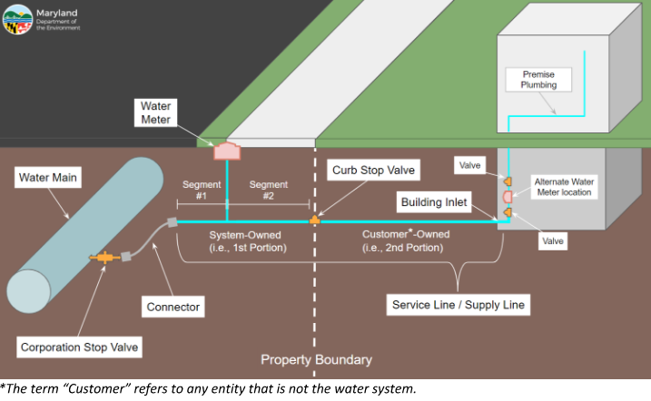

Slide 3
FAQ
Why did I receive a notification letter stating that my service line has an Unknown Lead Classification?
  The Town of Berlin has recently completed the federal and state requirements for the initial Lead Service Line Inventory. As part of the federal requirements, all services that have unknown material information on either the system-owned portion or the customer-owned portion receive a notification letter in the mail. Further investigation is required for these properties to identify the service line material.
As a Property Owner/Resident with an Unknown Lead service line classification, do I need to do anything?
  The federal requirements for the Lead Service Line Inventory mandate that all unknown service lines be identified. To accomplish this, the Town is asking all property owners/residents who received a notification letter to provide the Town with any information regarding the water service line. This includes the service line material and the installation date if possible. Photographic evidence, if possible, is highly recommended. The Town will be continuing investigation efforts, including test pitting the unknown water service lines.

Slide 4
FAQ
Does my service line need to be replaced?
  Unknown service line materials need to be identified. If a service line material is found to be Lead or Galvanized Iron Pipe, then that service line needs to be replaced in its entirety. If the service line material is identified plastic or copper, then it does not need to be replaced.
What is the Town of Berlin doing to minimize the costs of being passed along to the users?
  The Town of Berlin has been and continues to actively seek federal and state funding assistance for the Lead Service Line Investigation & Replacement projects, which covers all identification efforts for every water service line in the Town.
  The Town of Berlin has secured funding for the first phase of the Lead Service Line Replacement project and is actively seeking funding for future phases.
Where can I find a copy of the Lead Service Line Inventory?
  Concerned Residents and Property Owners, can visit Town Hall and request to view the Lead Service Line Inventory, the property street address and water billing account number are required to identify the correct account within the inventory.

Slide 5
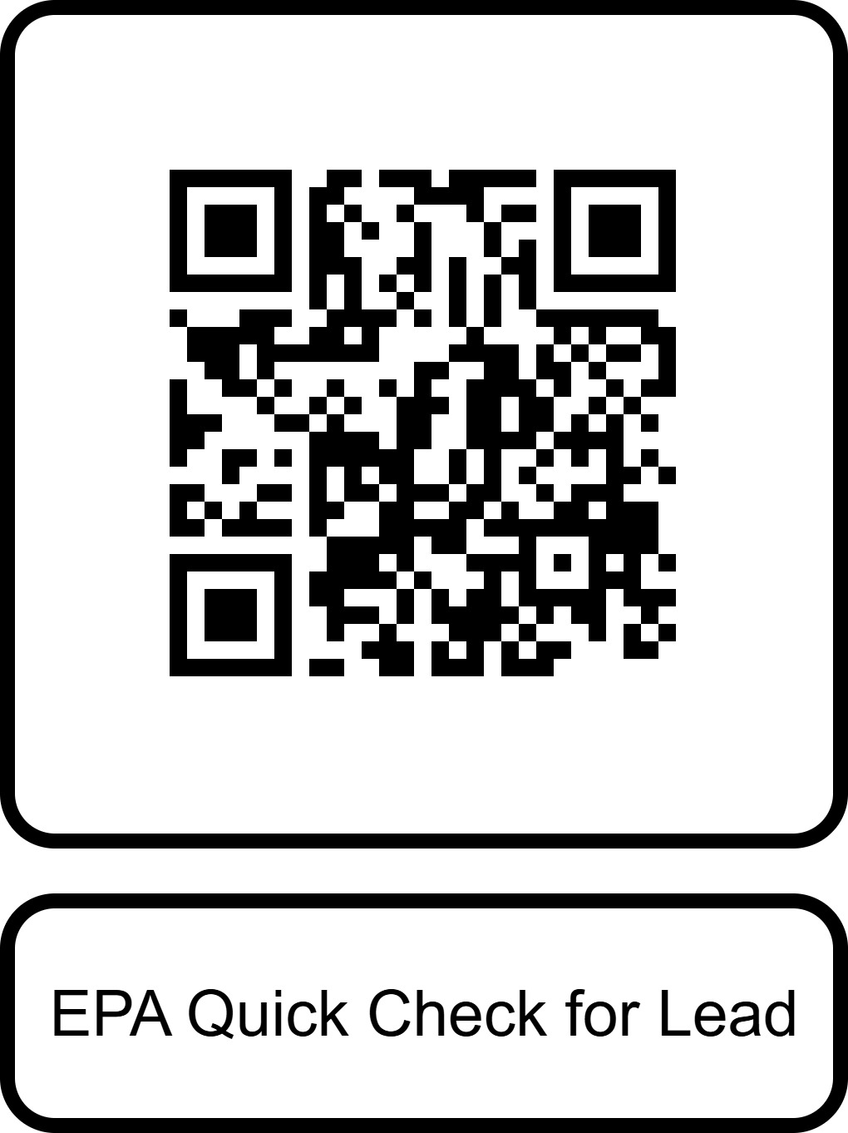
Additional Information
www.epa.gov/ground-water-and-drinking-water/protect-your-tap-quick-check-lead

