Slide 1
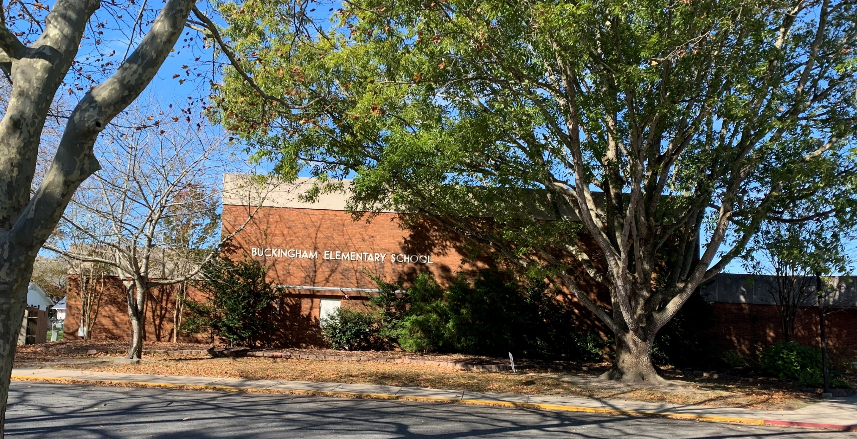


BUCKINGHAM ELEMENTARY REPLACEMENT SCHOOL
Planning Commission Presentation
8.12.2026

Slide 2

AGENDA
Project Schedule
Planning Process Overview
Site & Floor Plan Review
Renderings & Exterior Animation
Introduce Construction Manager

Slide 3
SCHEDULE
PLANNING
Feasibility Study | 2022
Educational Specifications & Programming | 2023
Conceptual Planning Committee | April – June 2023
Schematic Design | January – April 2025
May 20: Board of Education Presentation & Approval
June 5: Town of Berlin Project Review Kickoff
June 17: Worcester County Commissioners Approval
Design Development | May – October 2025
September 17: Staff Presentation
October 15: Conceptual Planning Committee Update
October 27: Community Presentation @ BES
Construction Documents | November 2025 – June 2026
Approvals & Bidding | July 2026 – February 2027
August 2026: 100% Bidding Documents
October 2026: Bid Opening
November 2026: Board of Education Approval
December 2026: Worcester County Commissioners
February 2027: IAC / State Contract Approval
Construction Phase | Spring 2027 – Fall 2029
2022 - 2023
DESIGN
2025 - 2026
BUILD
2027-2029

Slide 4
SCHEDULE
PLANNING
Feasibility Study | 2022
Educational Specifications & Programming | 2023
Conceptual Planning Committee | April – June 2023
Schematic Design | January – April 2025
May 20: Board of Education Presentation & Approval
June 5: Town of Berlin Project Review Kickoff
June 17: Worcester County Commissioners Approval
Design Development | May – October 2025
September 17: Staff Presentation
October 15: Conceptual Planning Committee Update
October 27: Community Presentation @ BES
Construction Documents | November 2025 – June 2026
Approvals & Bidding | July 2026 – February 2027
August 2026: 100% Bidding Documents
October 2026: Bid Opening
November 2026: Board of Education Approval
December 2026: Worcester County Commissioners
February 2027: IAC / State Contract Approval
Construction Phase | Spring 2027 – Fall 2029
2022 - 2023
DESIGN
2025 - 2026
BUILD
2027-2029

Slide 5
SCHEDULE
PLANNING
Feasibility Study | 2022
Educational Specifications & Programming | 2023
Conceptual Planning Committee | April – June 2023
Schematic Design | January – April 2025
May 20: Board of Education Presentation & Approval
June 5: Town of Berlin Project Review Kickoff
June 17: Worcester County Commissioners Approval
Design Development | May – October 2025
September 17: Staff Presentation
October 15: Conceptual Planning Committee Update
October 27: Community Presentation @ BES
Construction Documents | November 2025 – June 2026
Approvals & Bidding | July 2026 – February 2027
August 2026: 100% Bidding Documents
October 2026: Bid Opening
November 2026: Board of Education Approval
December 2026: Worcester County Commissioners
February 2027: IAC / State Contract Approval
Construction Phase | Spring 2027 – Fall 2029
2022 - 2023
DESIGN
2025 - 2026
BUILD
2027-2029

Slide 6
SCHEDULE
PLANNING
Feasibility Study | 2022
Educational Specifications & Programming | 2023
Conceptual Planning Committee | April – June 2023
Schematic Design | January – April 2025
May 20: Board of Education Presentation & Approval
June 5: Town of Berlin Project Review Kickoff
June 17: Worcester County Commissioners Approval
Design Development | May – October 2025
September 17: Staff Presentation
October 15: Conceptual Planning Committee Update
October 27: Community Presentation @ BES
Construction Documents | November 2025 – June 2026
Approvals & Bidding | July 2026 – February 2027
August 2026: 100% Bidding Documents
October 2026: Bid Opening
November 2026: Board of Education Approval
December 2026: Worcester County Commissioners
February 2027: IAC / State Contract Approval
Construction Phase | Spring 2027 – Fall 2029
2022 - 2023
DESIGN
2025 - 2026
BUILD
2027-2029

Slide 7
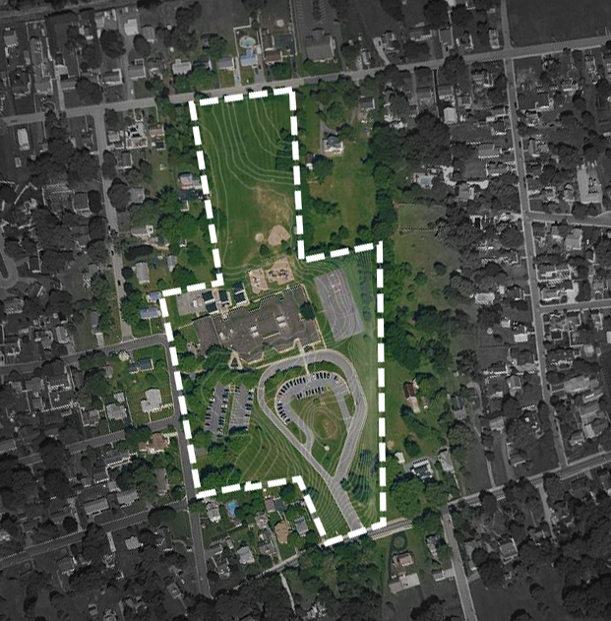
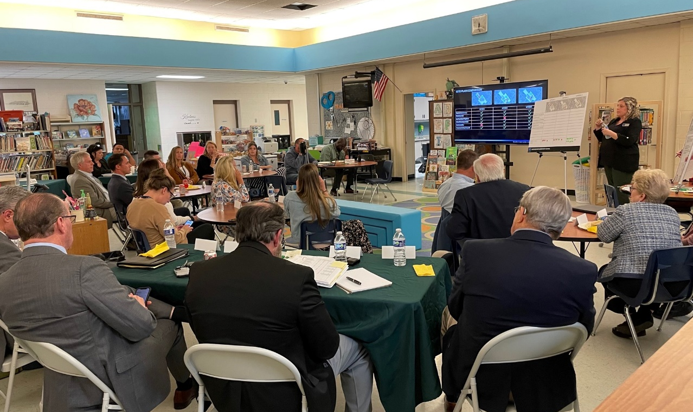
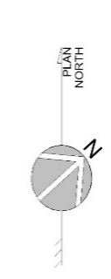
CONCEPTUAL PLANNING COMMITTEE
CPC Meetings
- April 12, 2023
- May 4, 2023
- May 16, 2023
- June 8, 2023
October 15, 2025 (Recap after project hold)
1
2
3

Slide 8
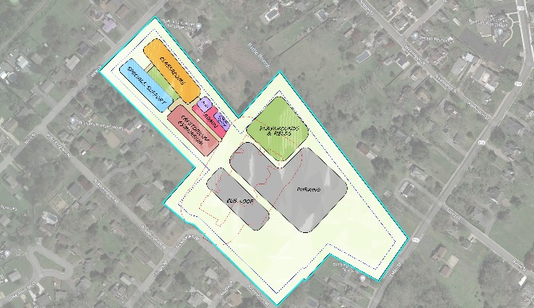
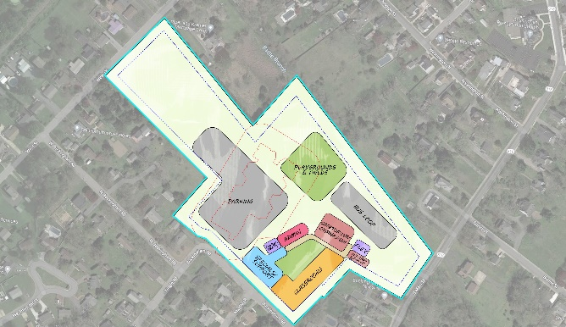
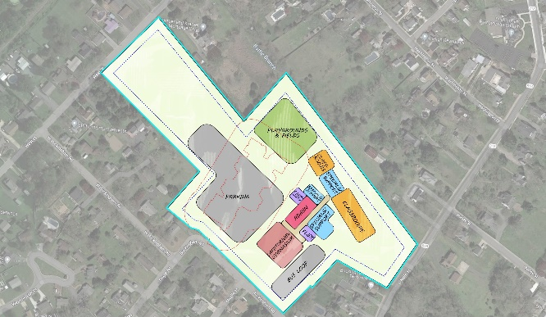
CONCEPTUAL PLANNING COMMITTEE
 | OPTION 1 | OPTION 2 | OPTION 3
Separate Bus/ Car loop
Pedestrian Path
Proximity to Neighbors
School Proximity to Fields
Constructability
Temporary Parking/ Drop Off

Slide 9
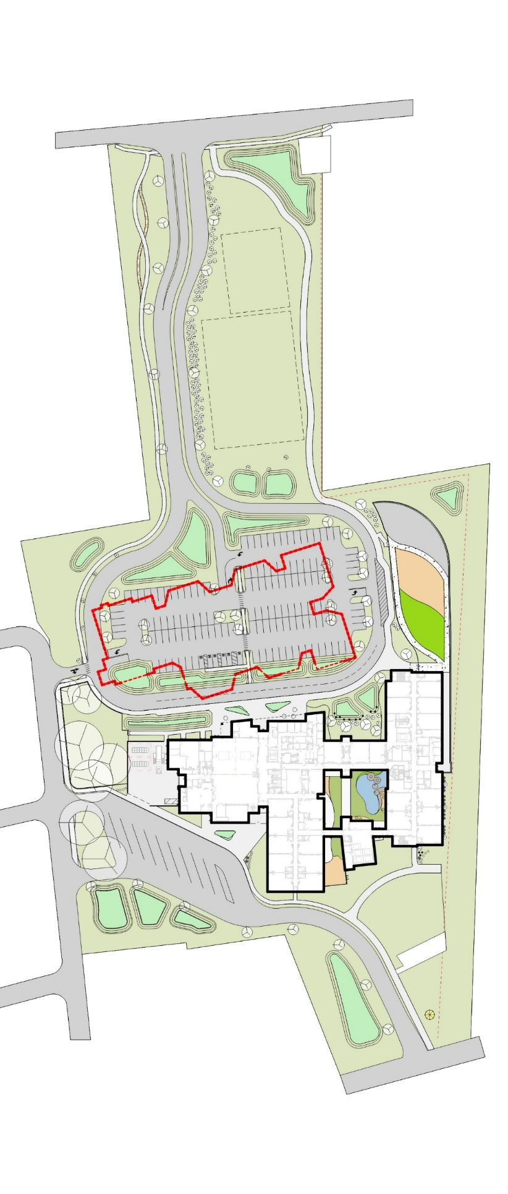
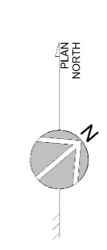
SITE PLAN
WEST STREET
ENTRY
CAR STACKING
BUCKINGHAM RD.
EXISTING SCHOOL
PLAY
NEW BUCKINGHAM
ELEMENTARY SCHOOL
COURTYARD
BUS
PARKING
MAIN STREET
BUS ENTRY

Slide 10


SITE PLAN
WEST STREET
BUCKINGHAM RD.
PLAY
NEW BUCKINGHAM
ELEMENTARY SCHOOL
COURTYARD
FIELDS
BUS
PARKING
MAIN STREET
BUS ENTRY

Slide 11

SITE PLAN
WEST STREET
BUCKINGHAM RD.
PLAYGROUND
PLAY
NEW BUCKINGHAM
ELEMENTARY SCHOOL
COURTYARD
BUS
PARKING
MAIN STREET
BUS ENTRY

Slide 12
SITE PLAN
WEST STREET
BUCKINGHAM RD.
TERRACED LAWN
PLAY
NEW BUCKINGHAM
ELEMENTARY SCHOOL
COURTYARD
BELL
TOWER
BUS
PARKING
MAIN STREET
BUS ENTRY

Slide 14
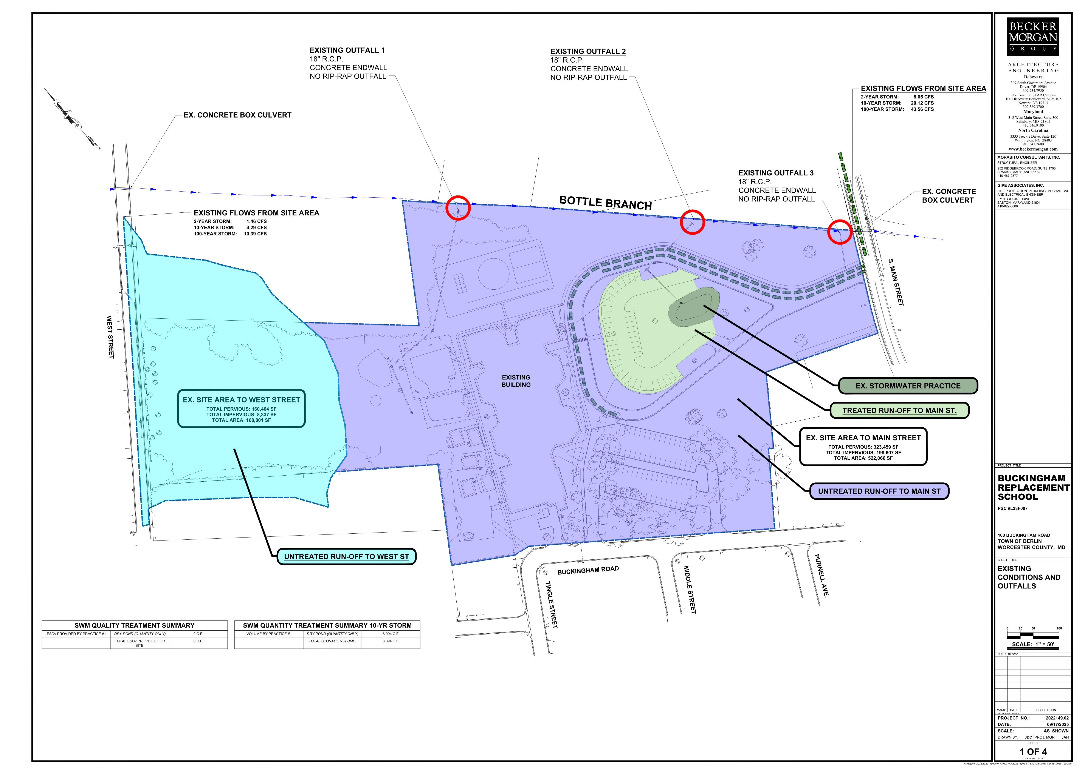

Slide 16
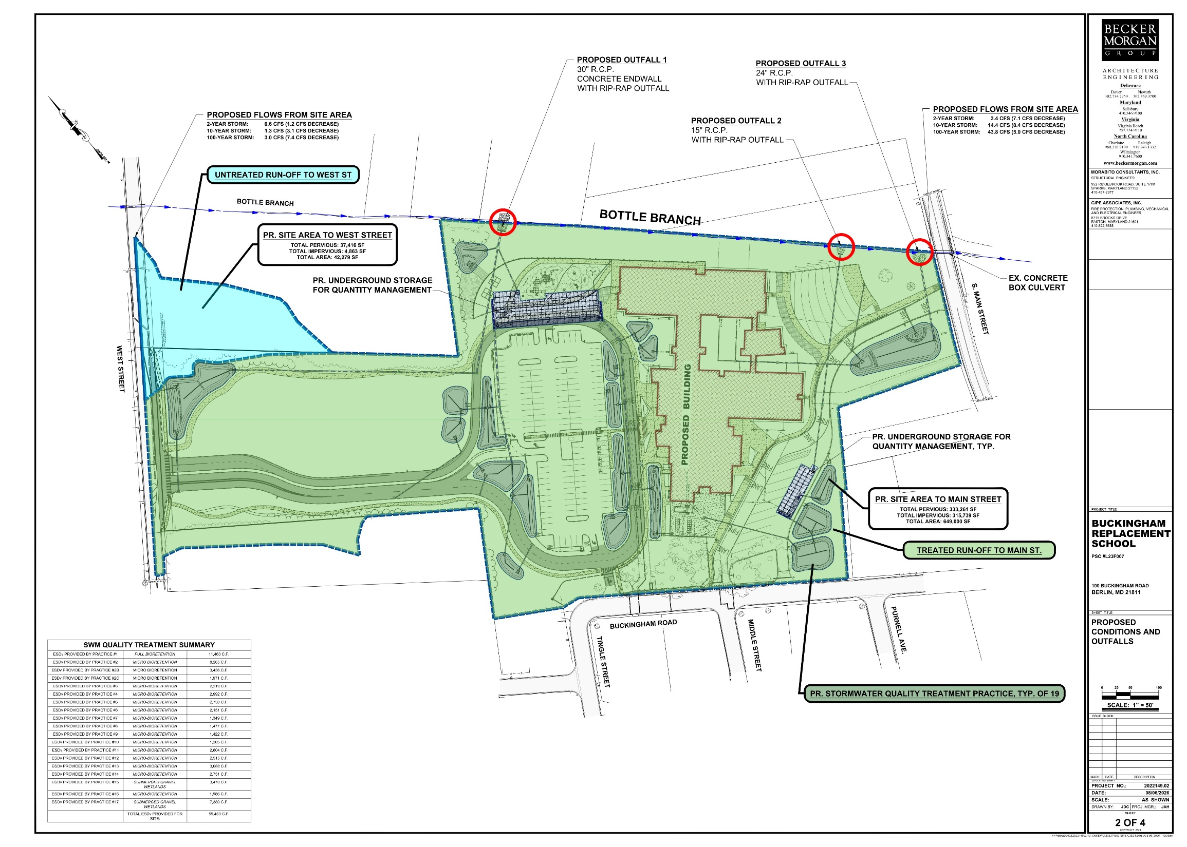

Slide 17
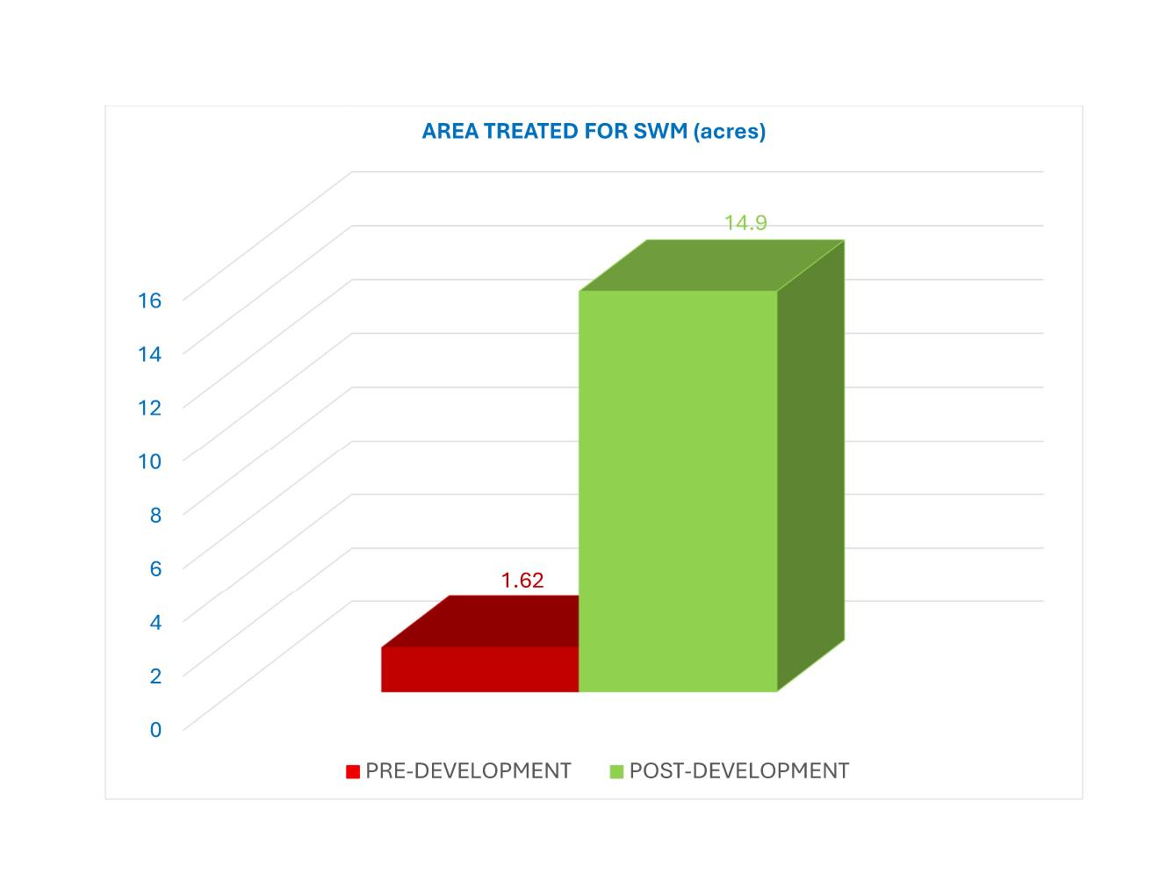

Slide 18
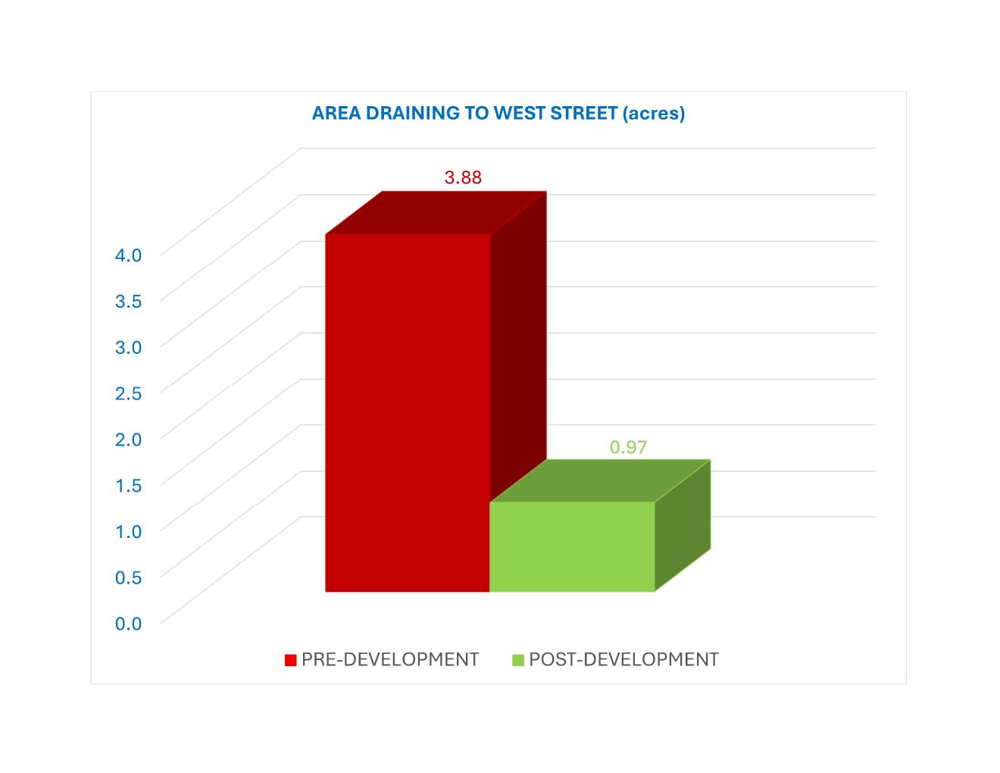

Slide 19
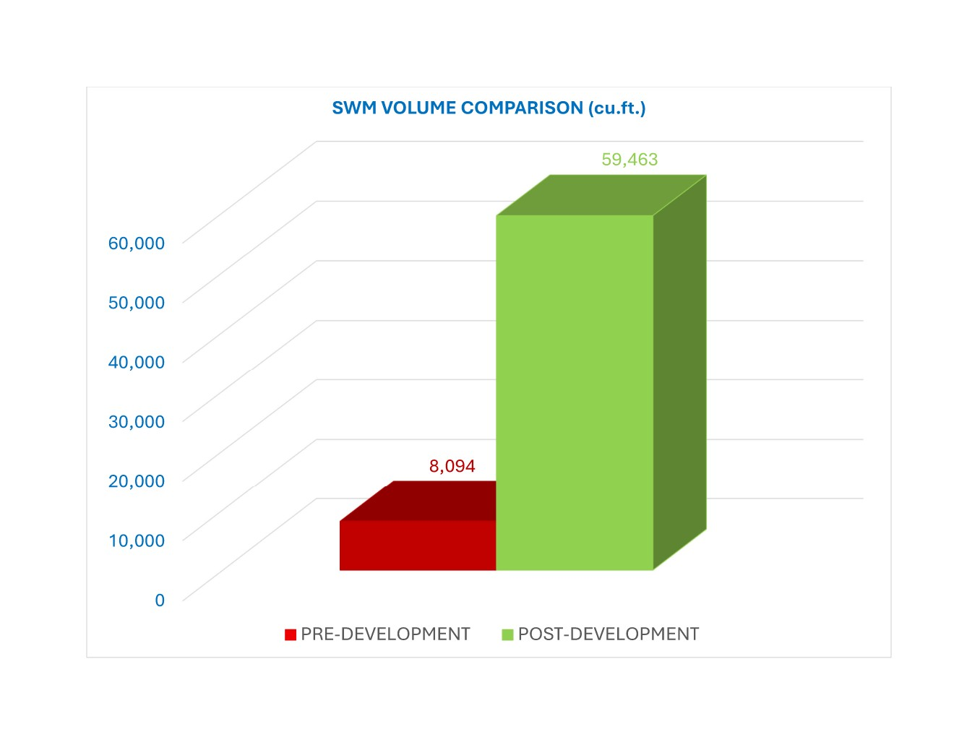

Slide 20
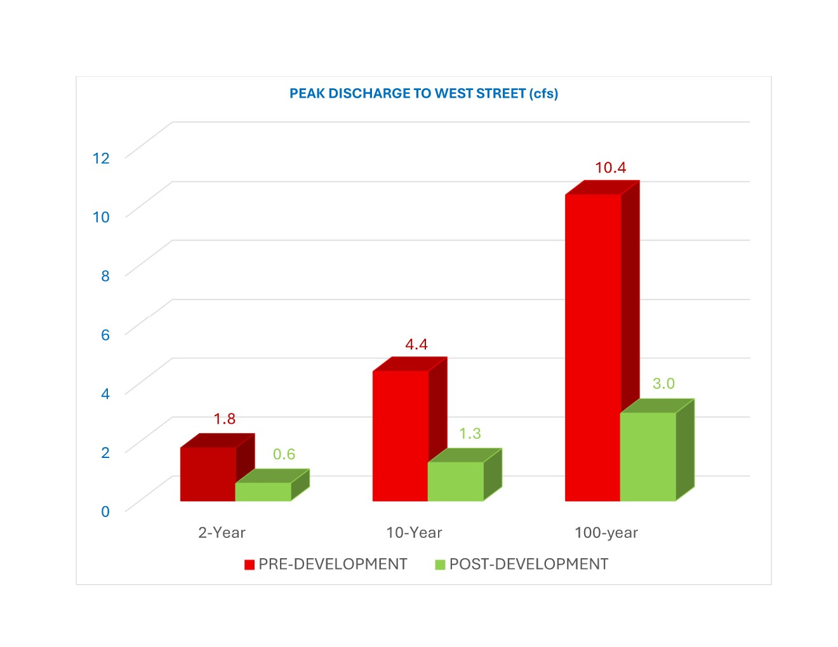

Slide 21
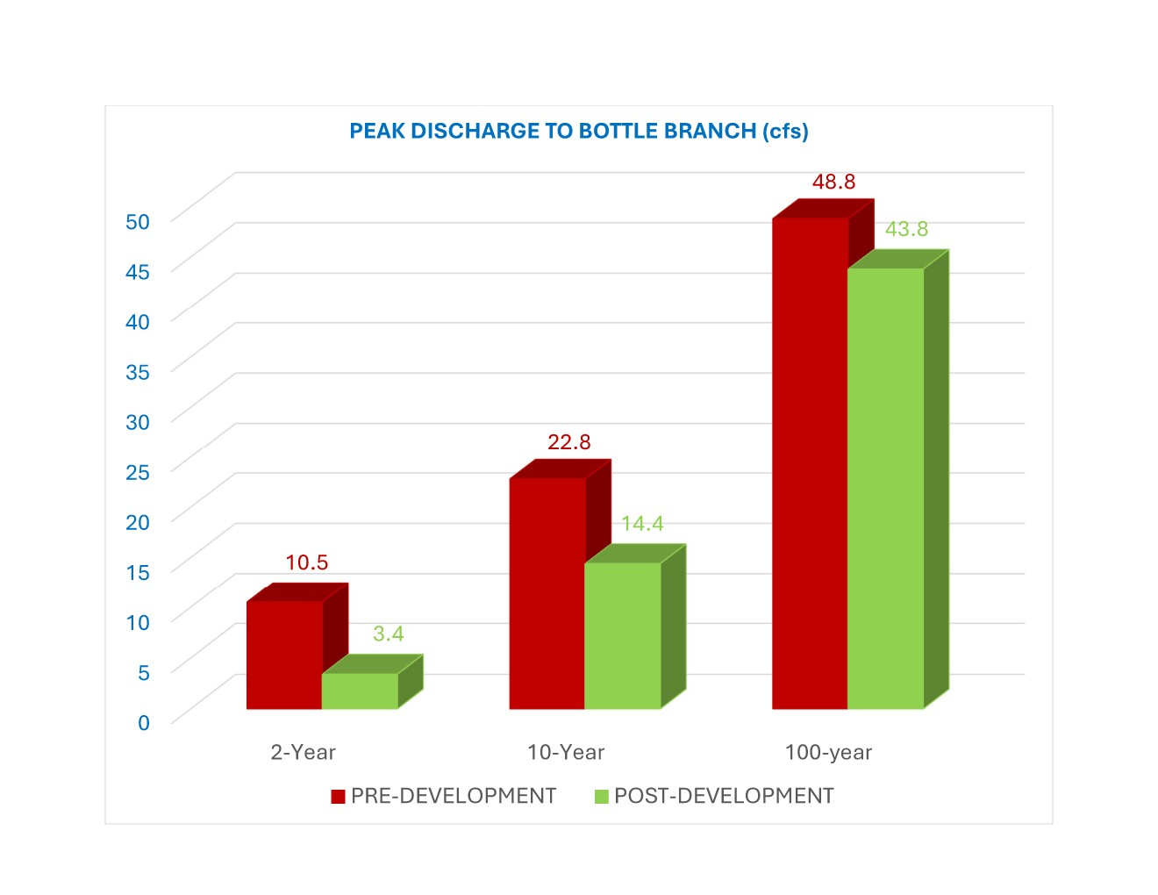

Slide 22
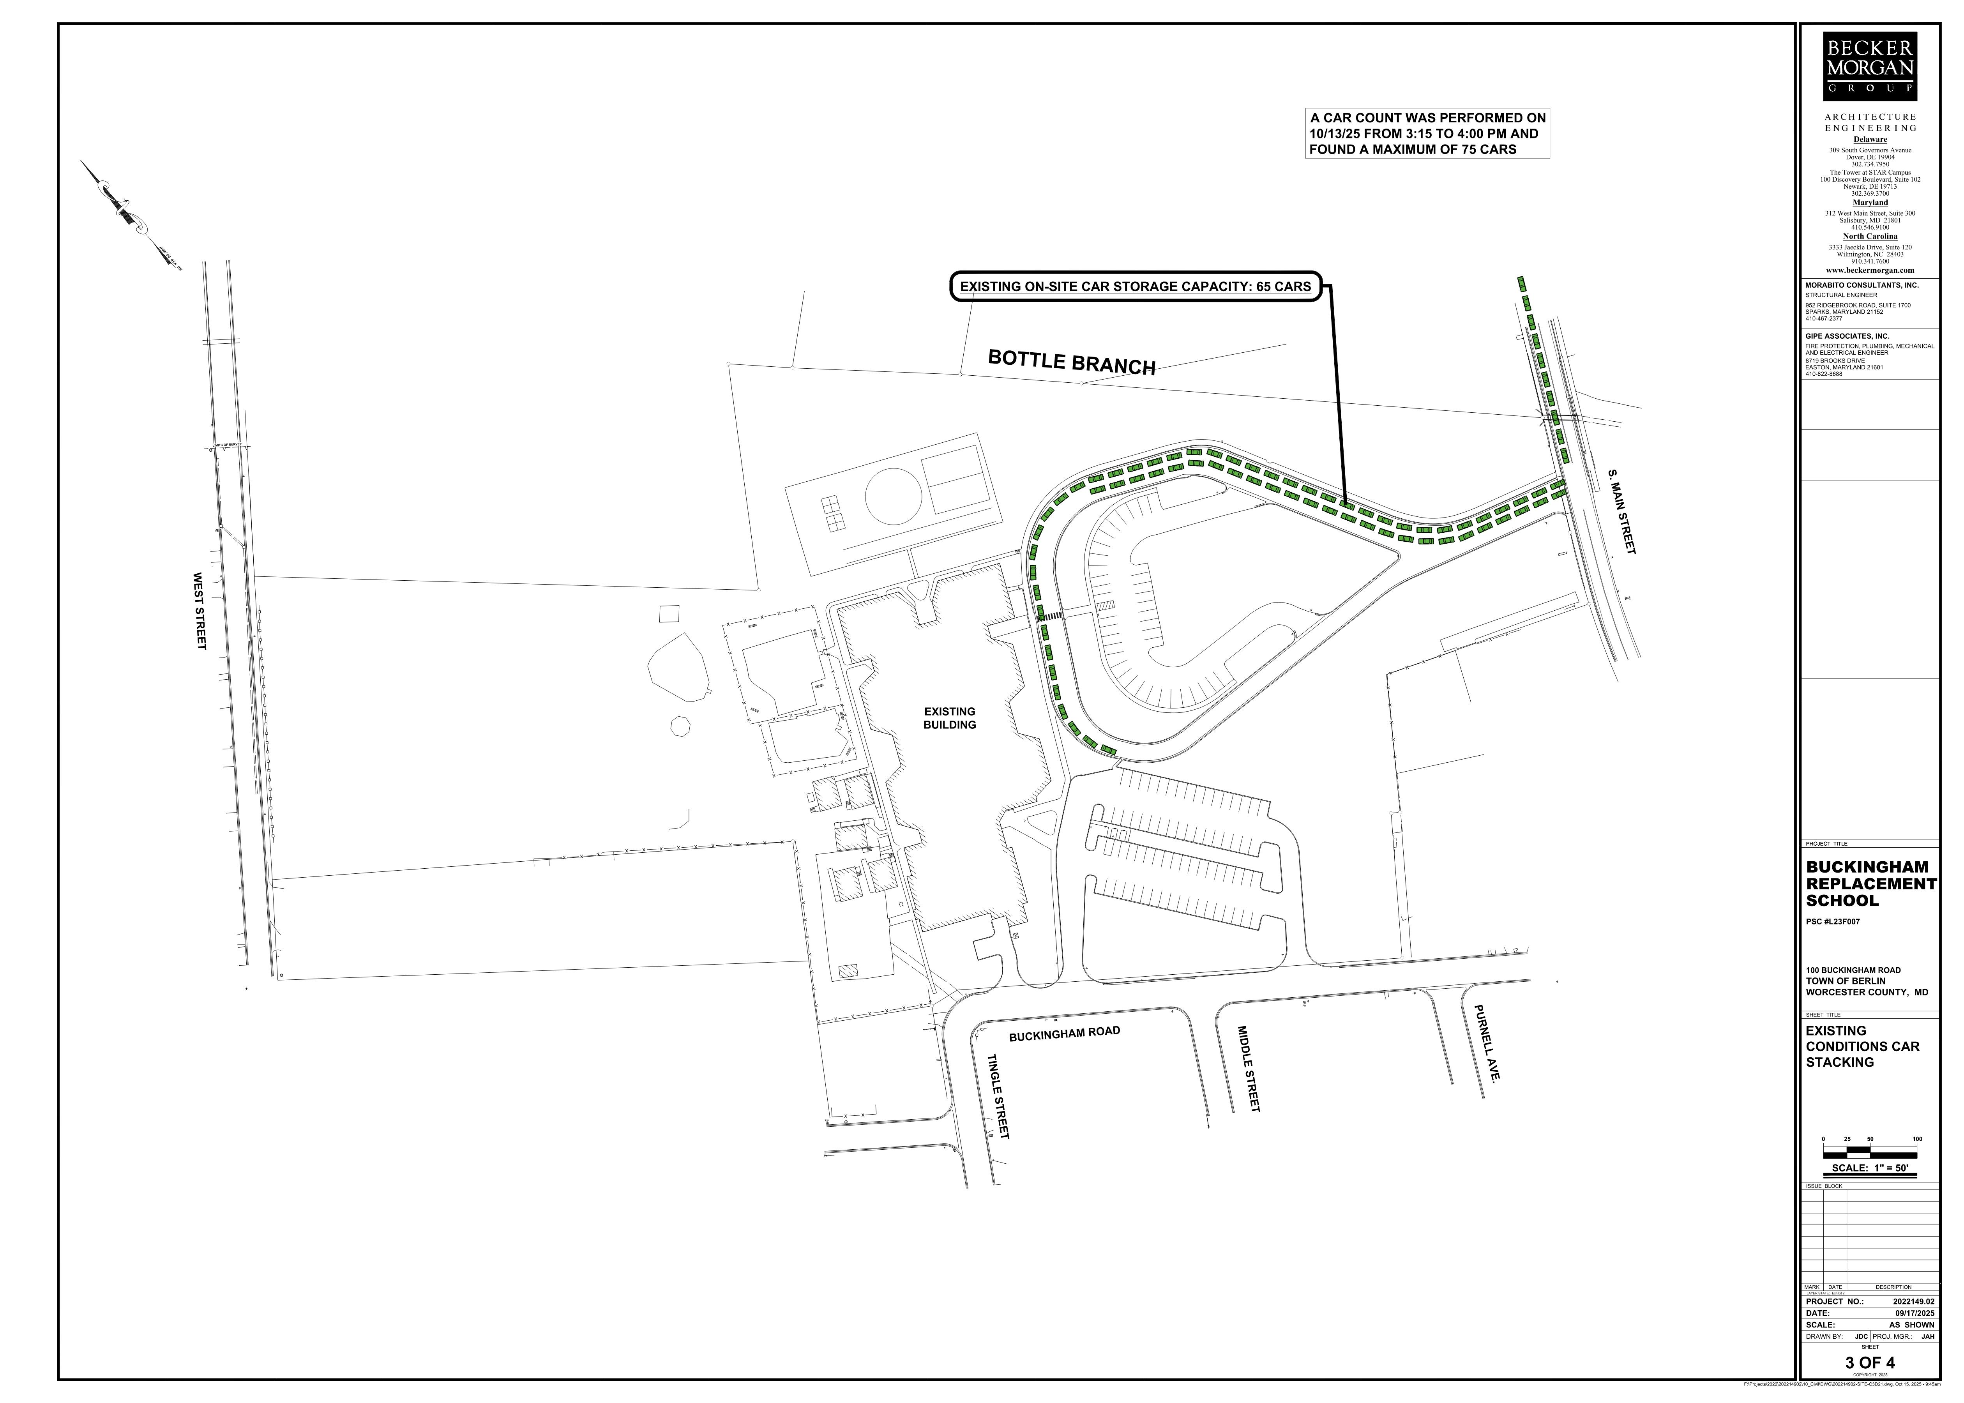
65 cars queued on site
10 cars queued on s. main street

Slide 23
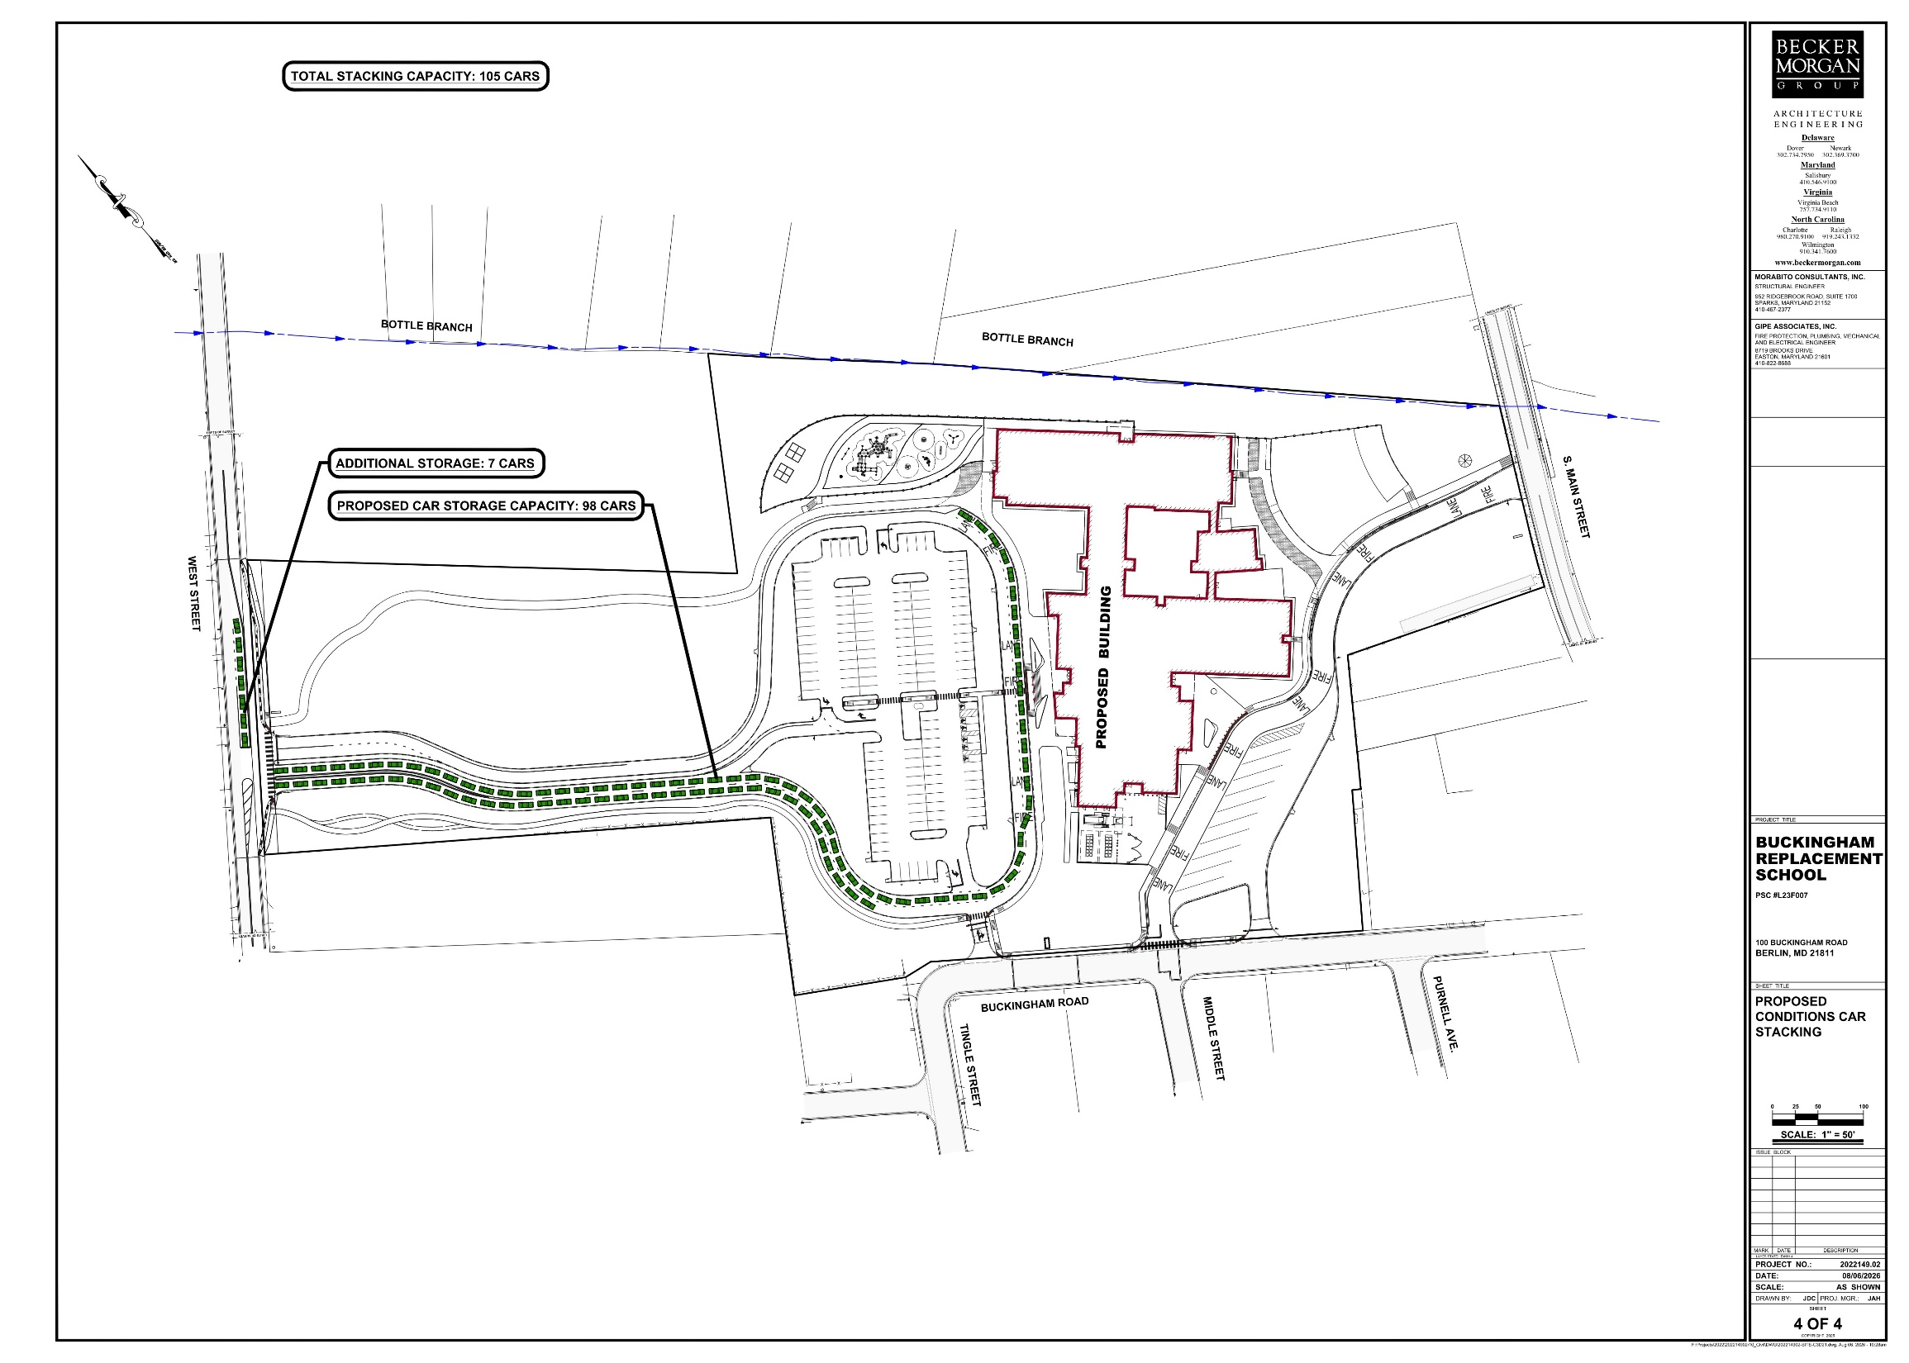
105 space proposed queue
= 61.5% increase in storage

Slide 24
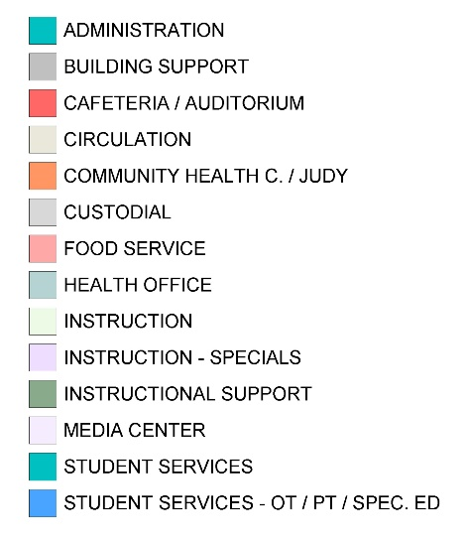
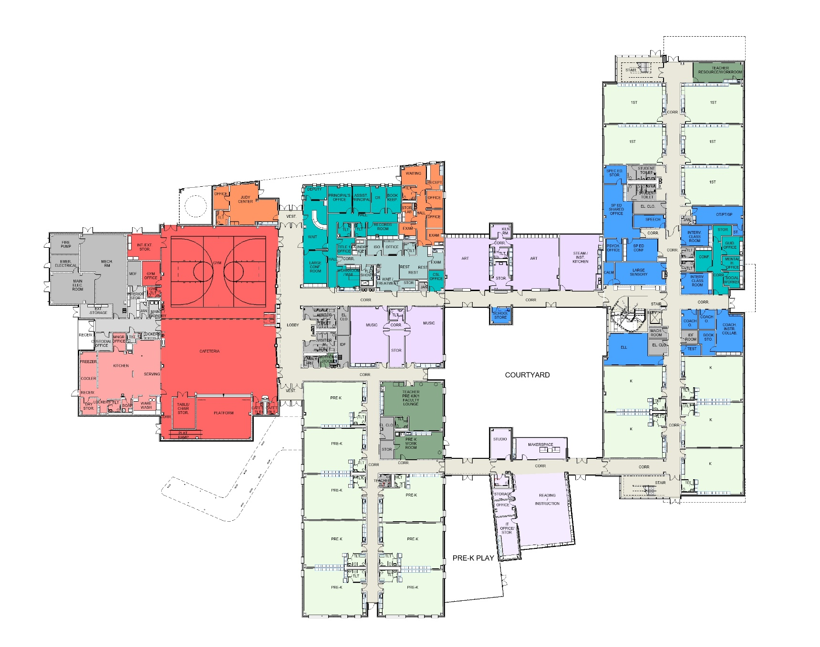
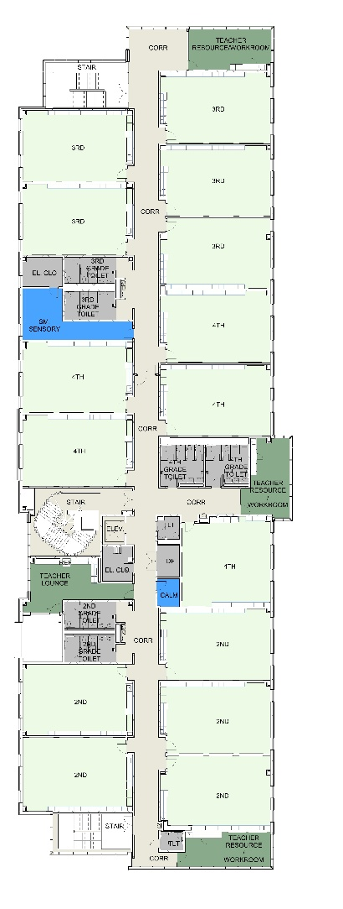
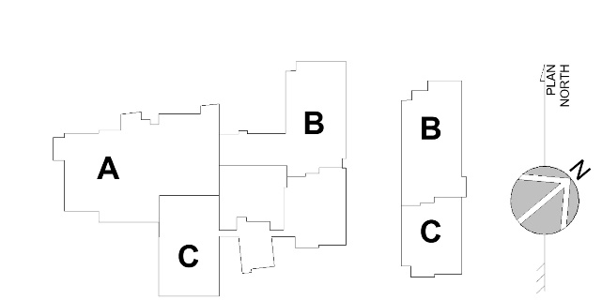
FLOOR PLAN
LEGEND
3RD GRADE
1ST GRADE
MAIN ENTRY
ADMIN. / HEALTH
ART
GYM
4TH GRADE
CAF.
MUSIC
KEYPLAN
BUS ENTRY
KINDERGARTEN
2ND GRADE
MEDIA
FIRST FLOOR
PK 3 & 4
SECOND FLOOR
FIRST FLOOR – 69,473 S.F.
SECOND FLOOR – 21,364 S.F.
TOTAL = 90,837 S.F.

Slide 25
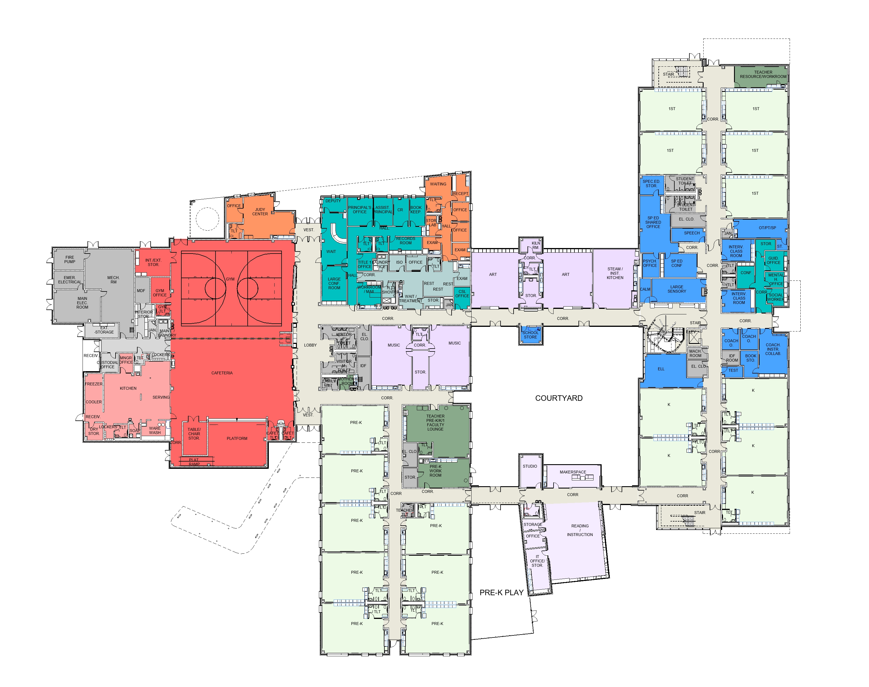
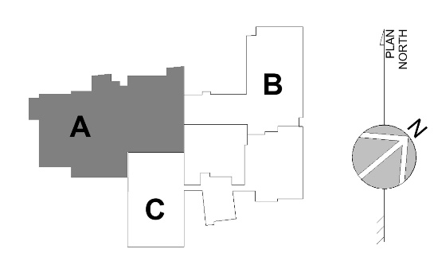
FLOOR PLAN
LEGEND
COMMUNITY
HEALTH
MAIN ENTRY
JUDY
CENTER
BIKE
RACKS
GYMNASIUM
KEYPLAN
SERVICE ENTRY
CAFETERIA
KITCHEN
BUS ENTRY
FIRST FLOOR PLAN – AREA A

Slide 26
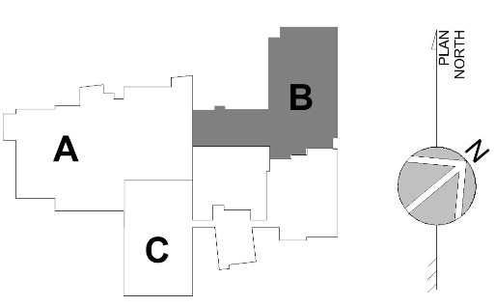
FLOOR PLAN
LEGEND
1
1
1
1
1ST GRADE
1
KEYPLAN
STEAM
ART
ART
PLAY
FIRST FLOOR PLAN – AREA B
MONUMENTAL STAIR

Slide 27
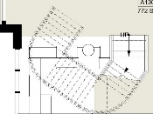

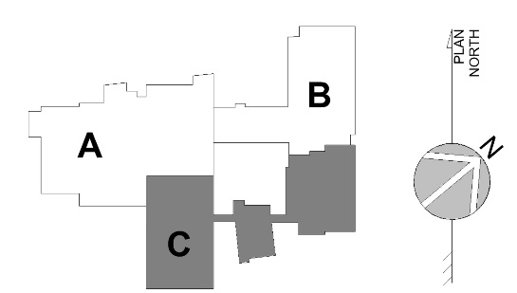
FLOOR PLAN
LEGEND
MONUMENTAL STAIR
COURTYARD
K
K
PK4
K
K
KEYPLAN
PK4
K
PK4
PK4
KINDERGARTEN
MEDIA
PK3
PK3
PRE-K PLAY
PK 3 & 4
PK3
PK3
FIRST FLOOR PLAN – AREA C

Slide 28
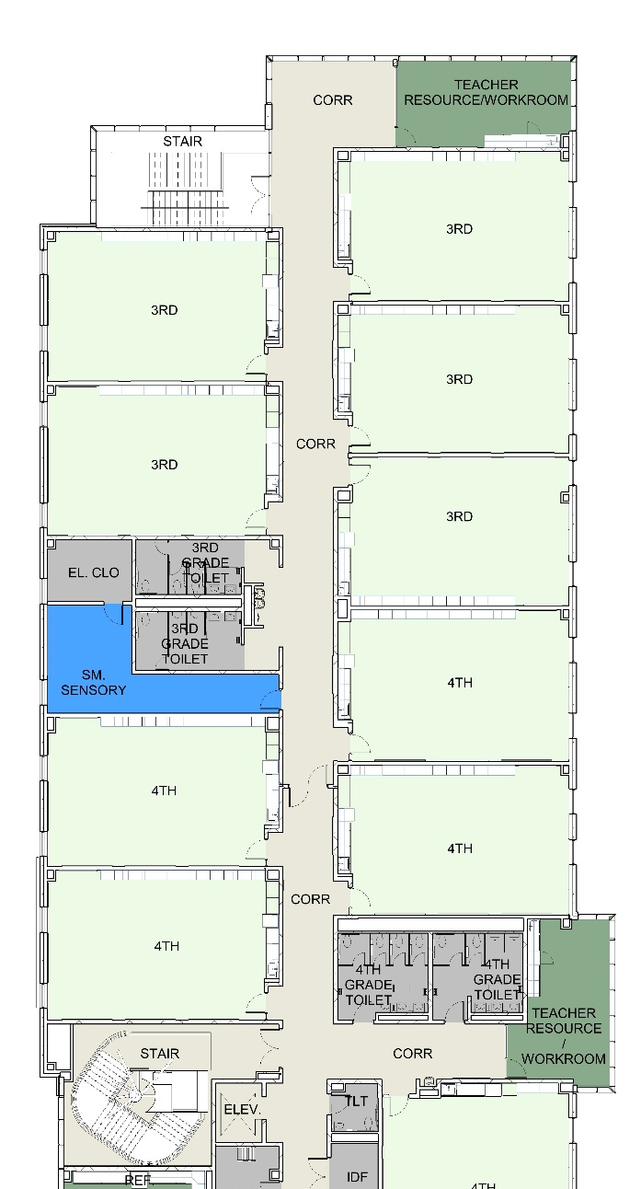
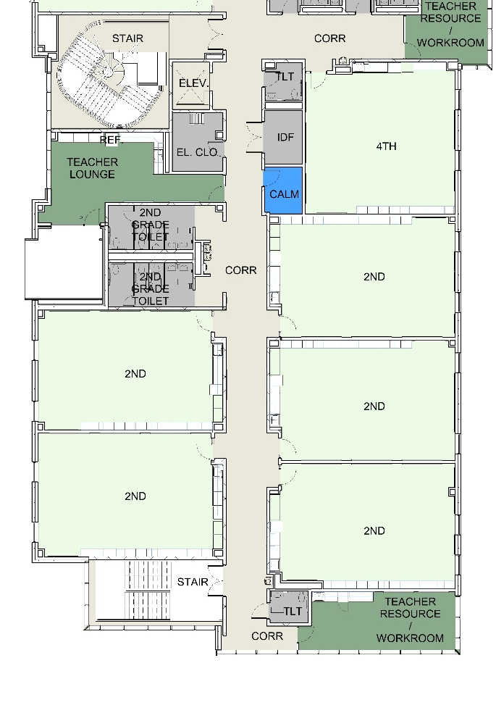
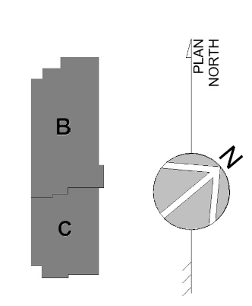
FLOOR PLAN
LEGEND
3
3
3RD GRADE
3
3
4
3
KEYPLAN
2
4
4
2
4
2
4TH GRADE
4
2
2ND GRADE
2
SECOND FLOOR PLAN – AREA B
SECOND FLOOR PLAN – AREA C

Slide 29
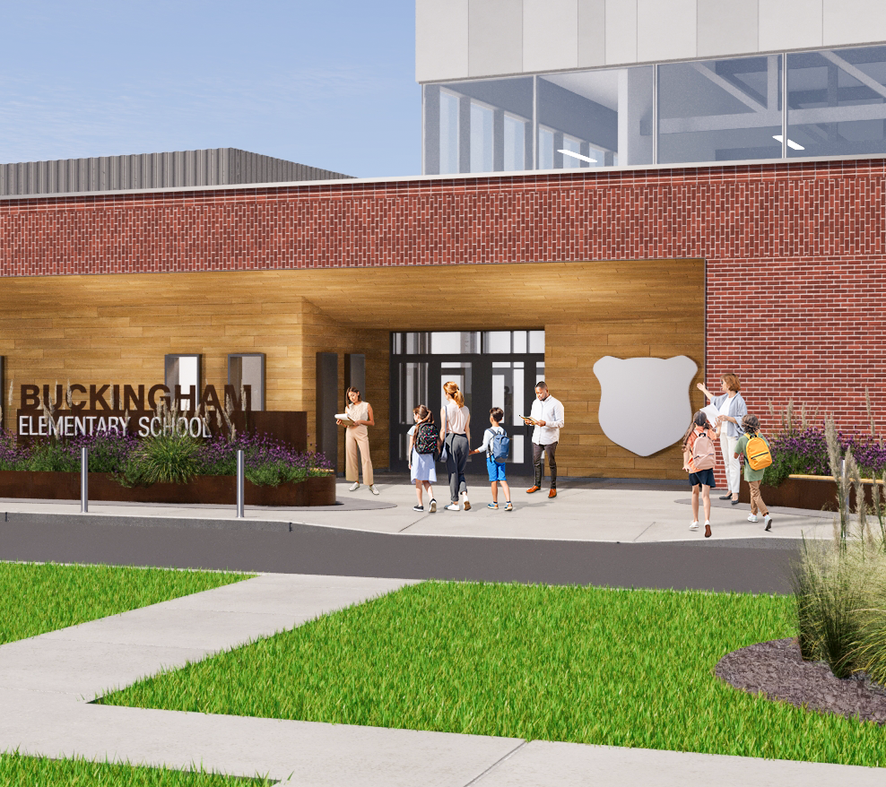
BUILDING EXTERIOR

Slide 30
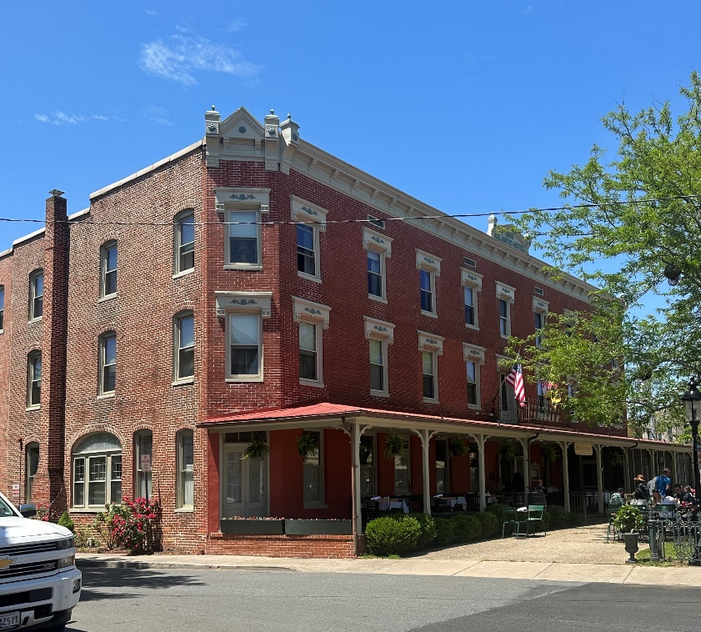
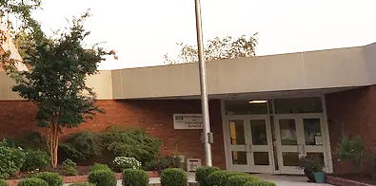
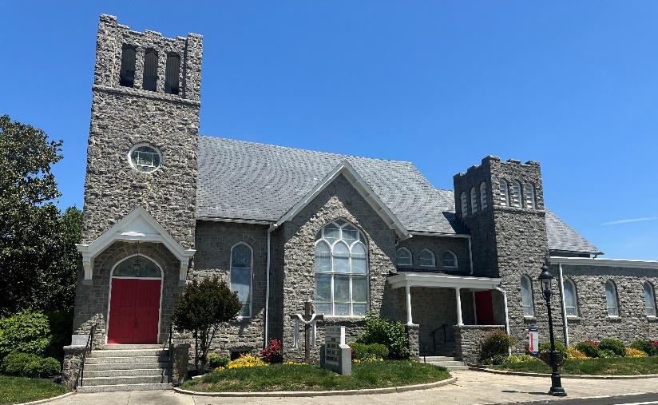
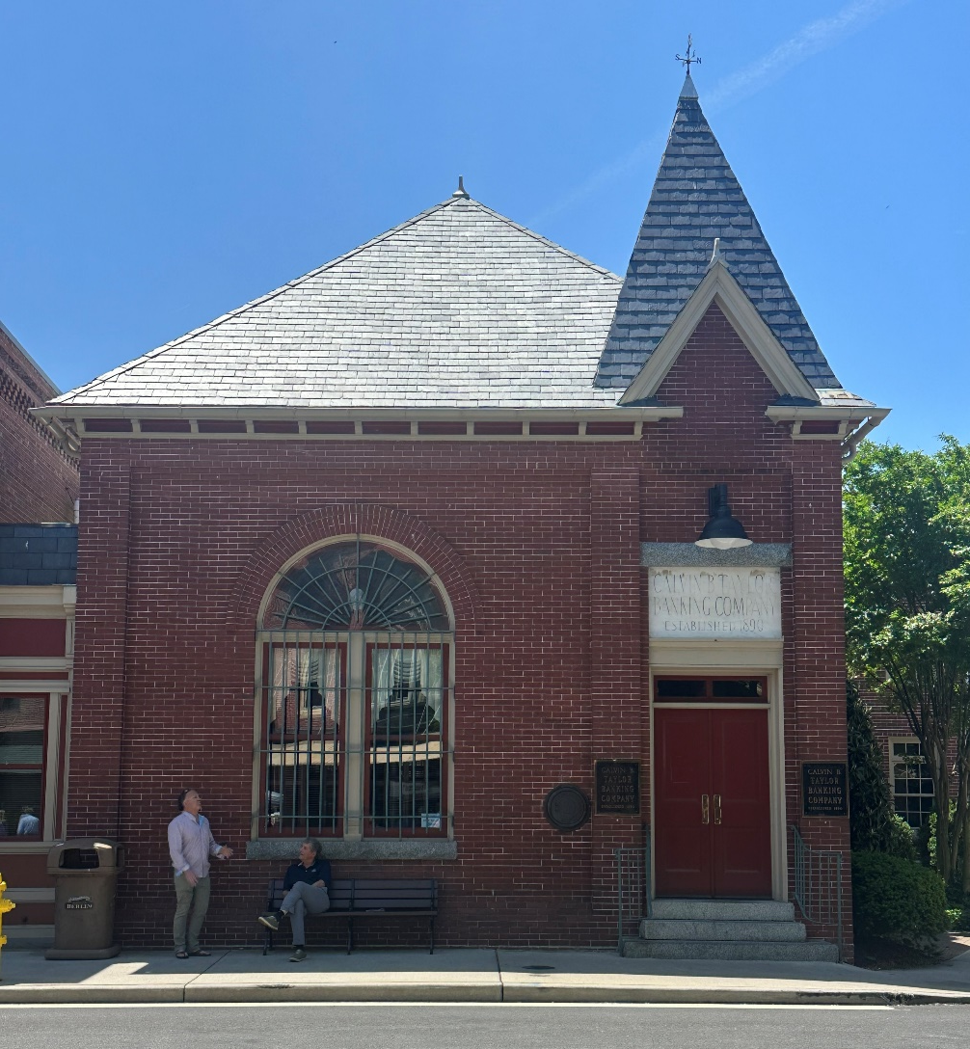
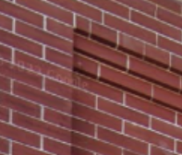
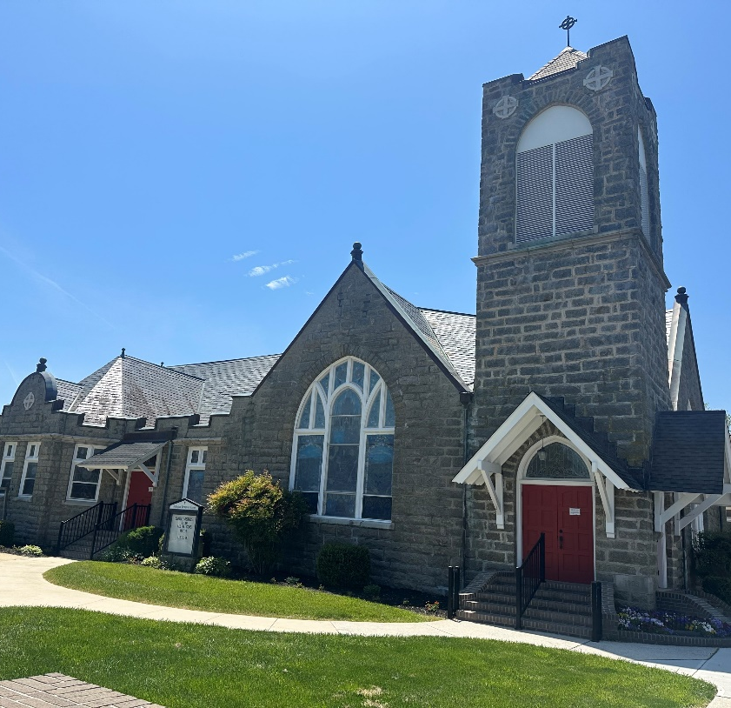
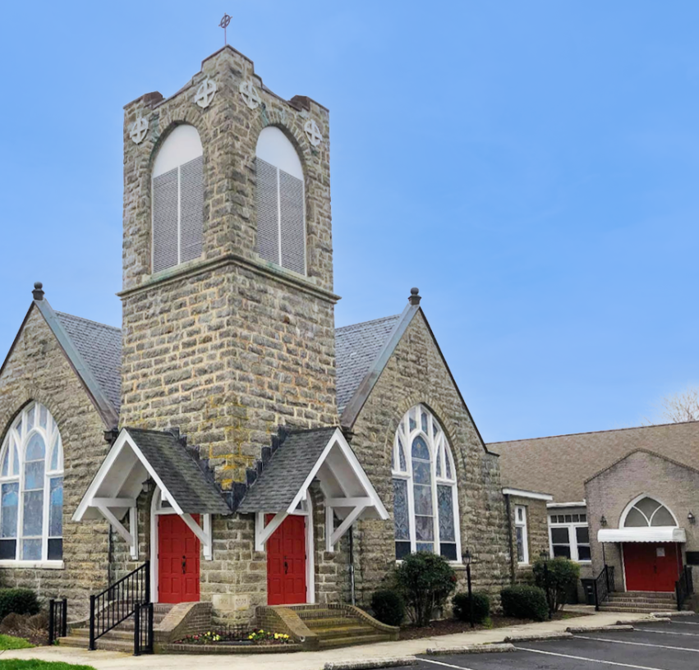


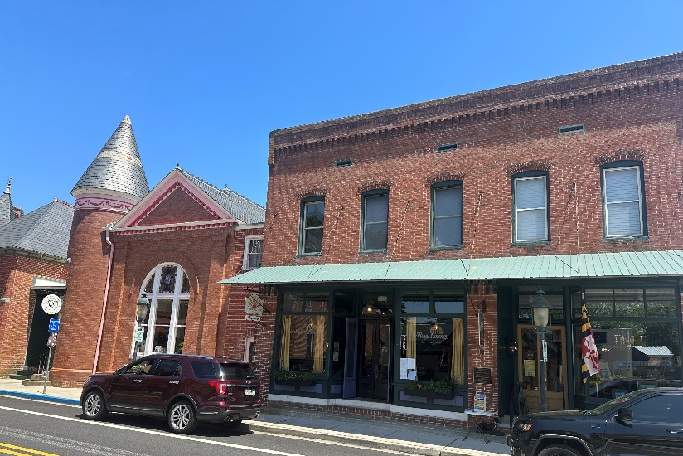
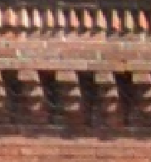
BERLIN
CONTEXT
DERIVING TONES, TEXTURES,
& FORM FROM THE LOCAL
VERNACULAR

Slide 31
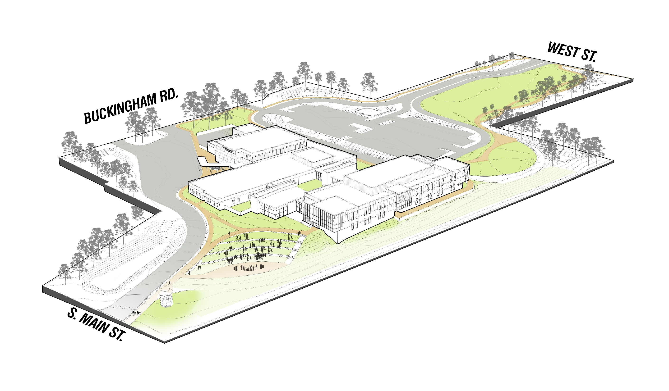
SITE AXON
UNIQUE PROPERTY FEATURES
TOPOGRAPHY
NEIGHBORHOOD ACCESSIBILITY
3 STREETS / 3 FRONTS

Slide 32
EXTERIOR
FOCUS AREAS

Slide 33
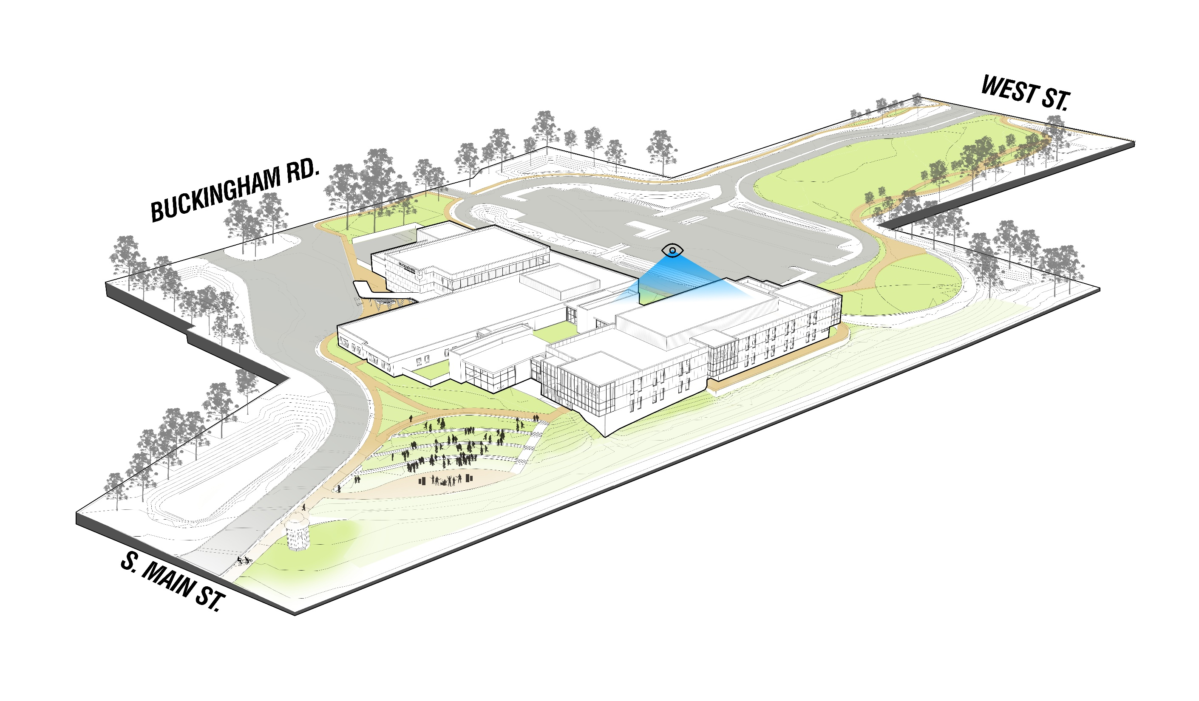
WEST ST. – CAR DROP OFF

Slide 34
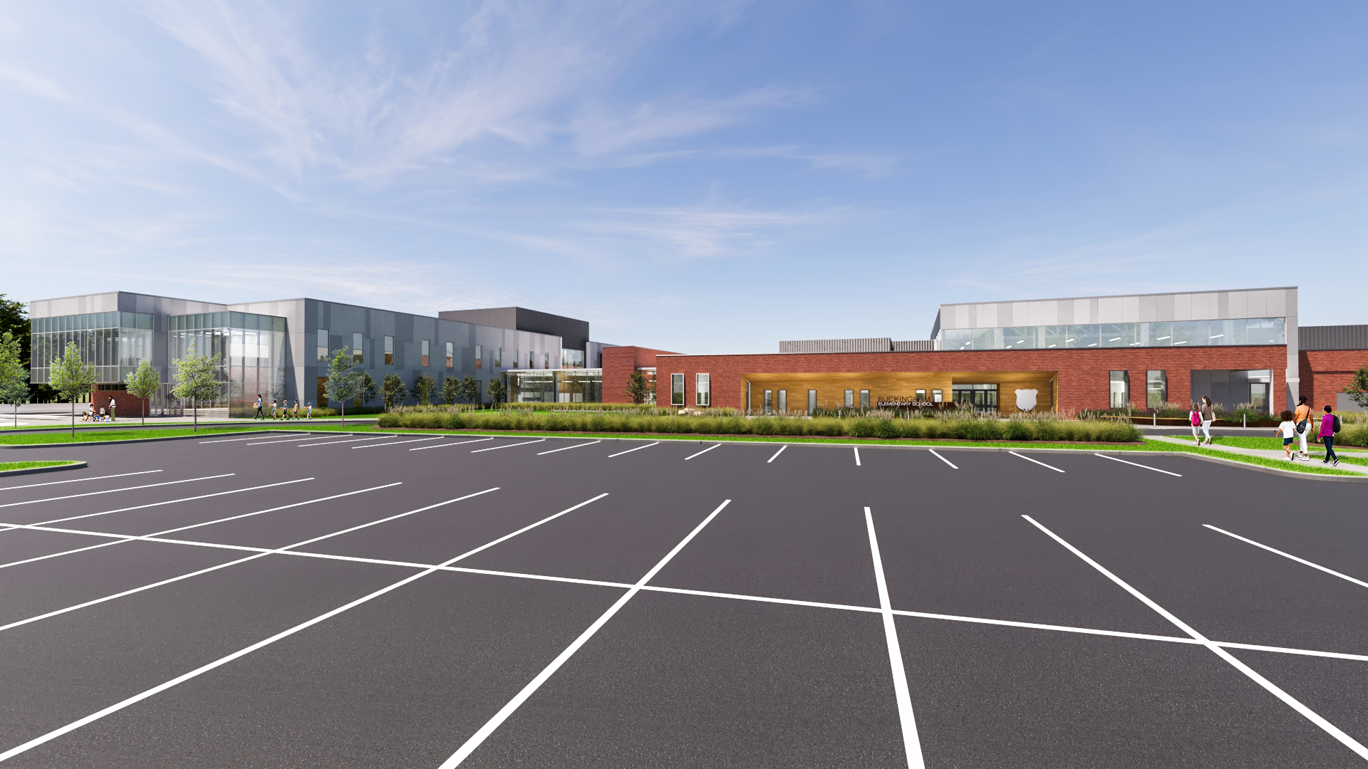
WEST ST. – CAR DROP OFF

Slide 35
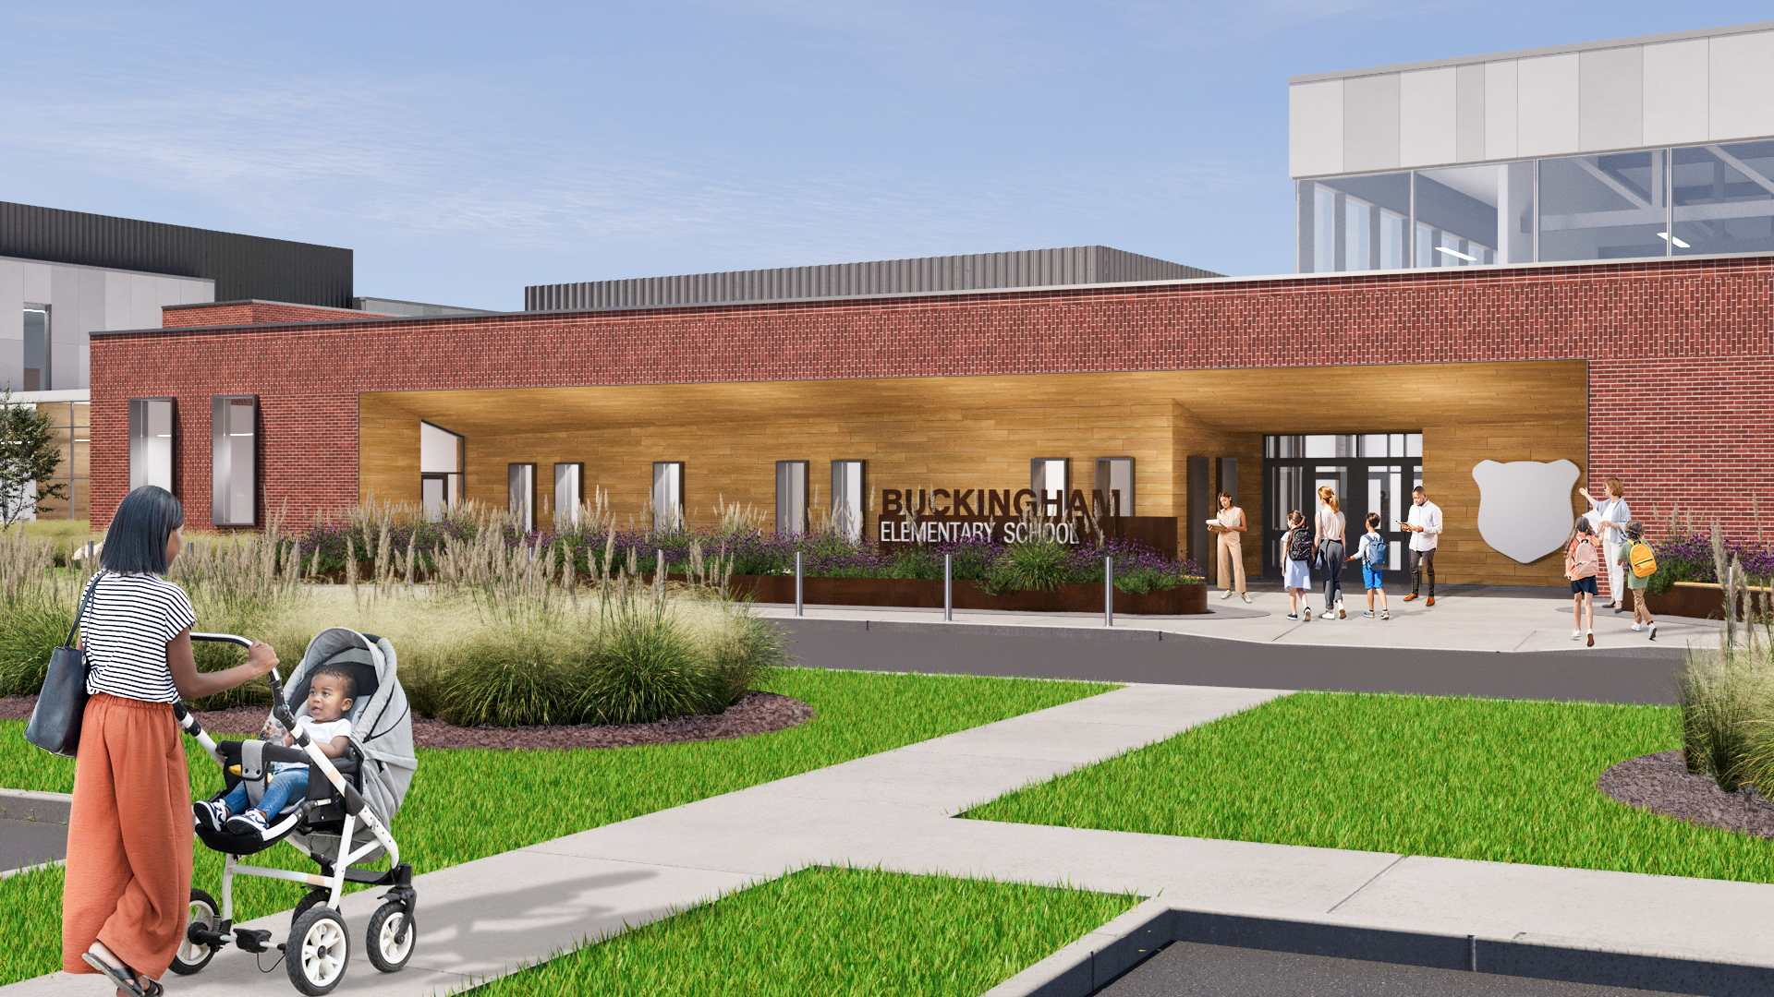
WEST ST. – CAR DROP OFF

Slide 36
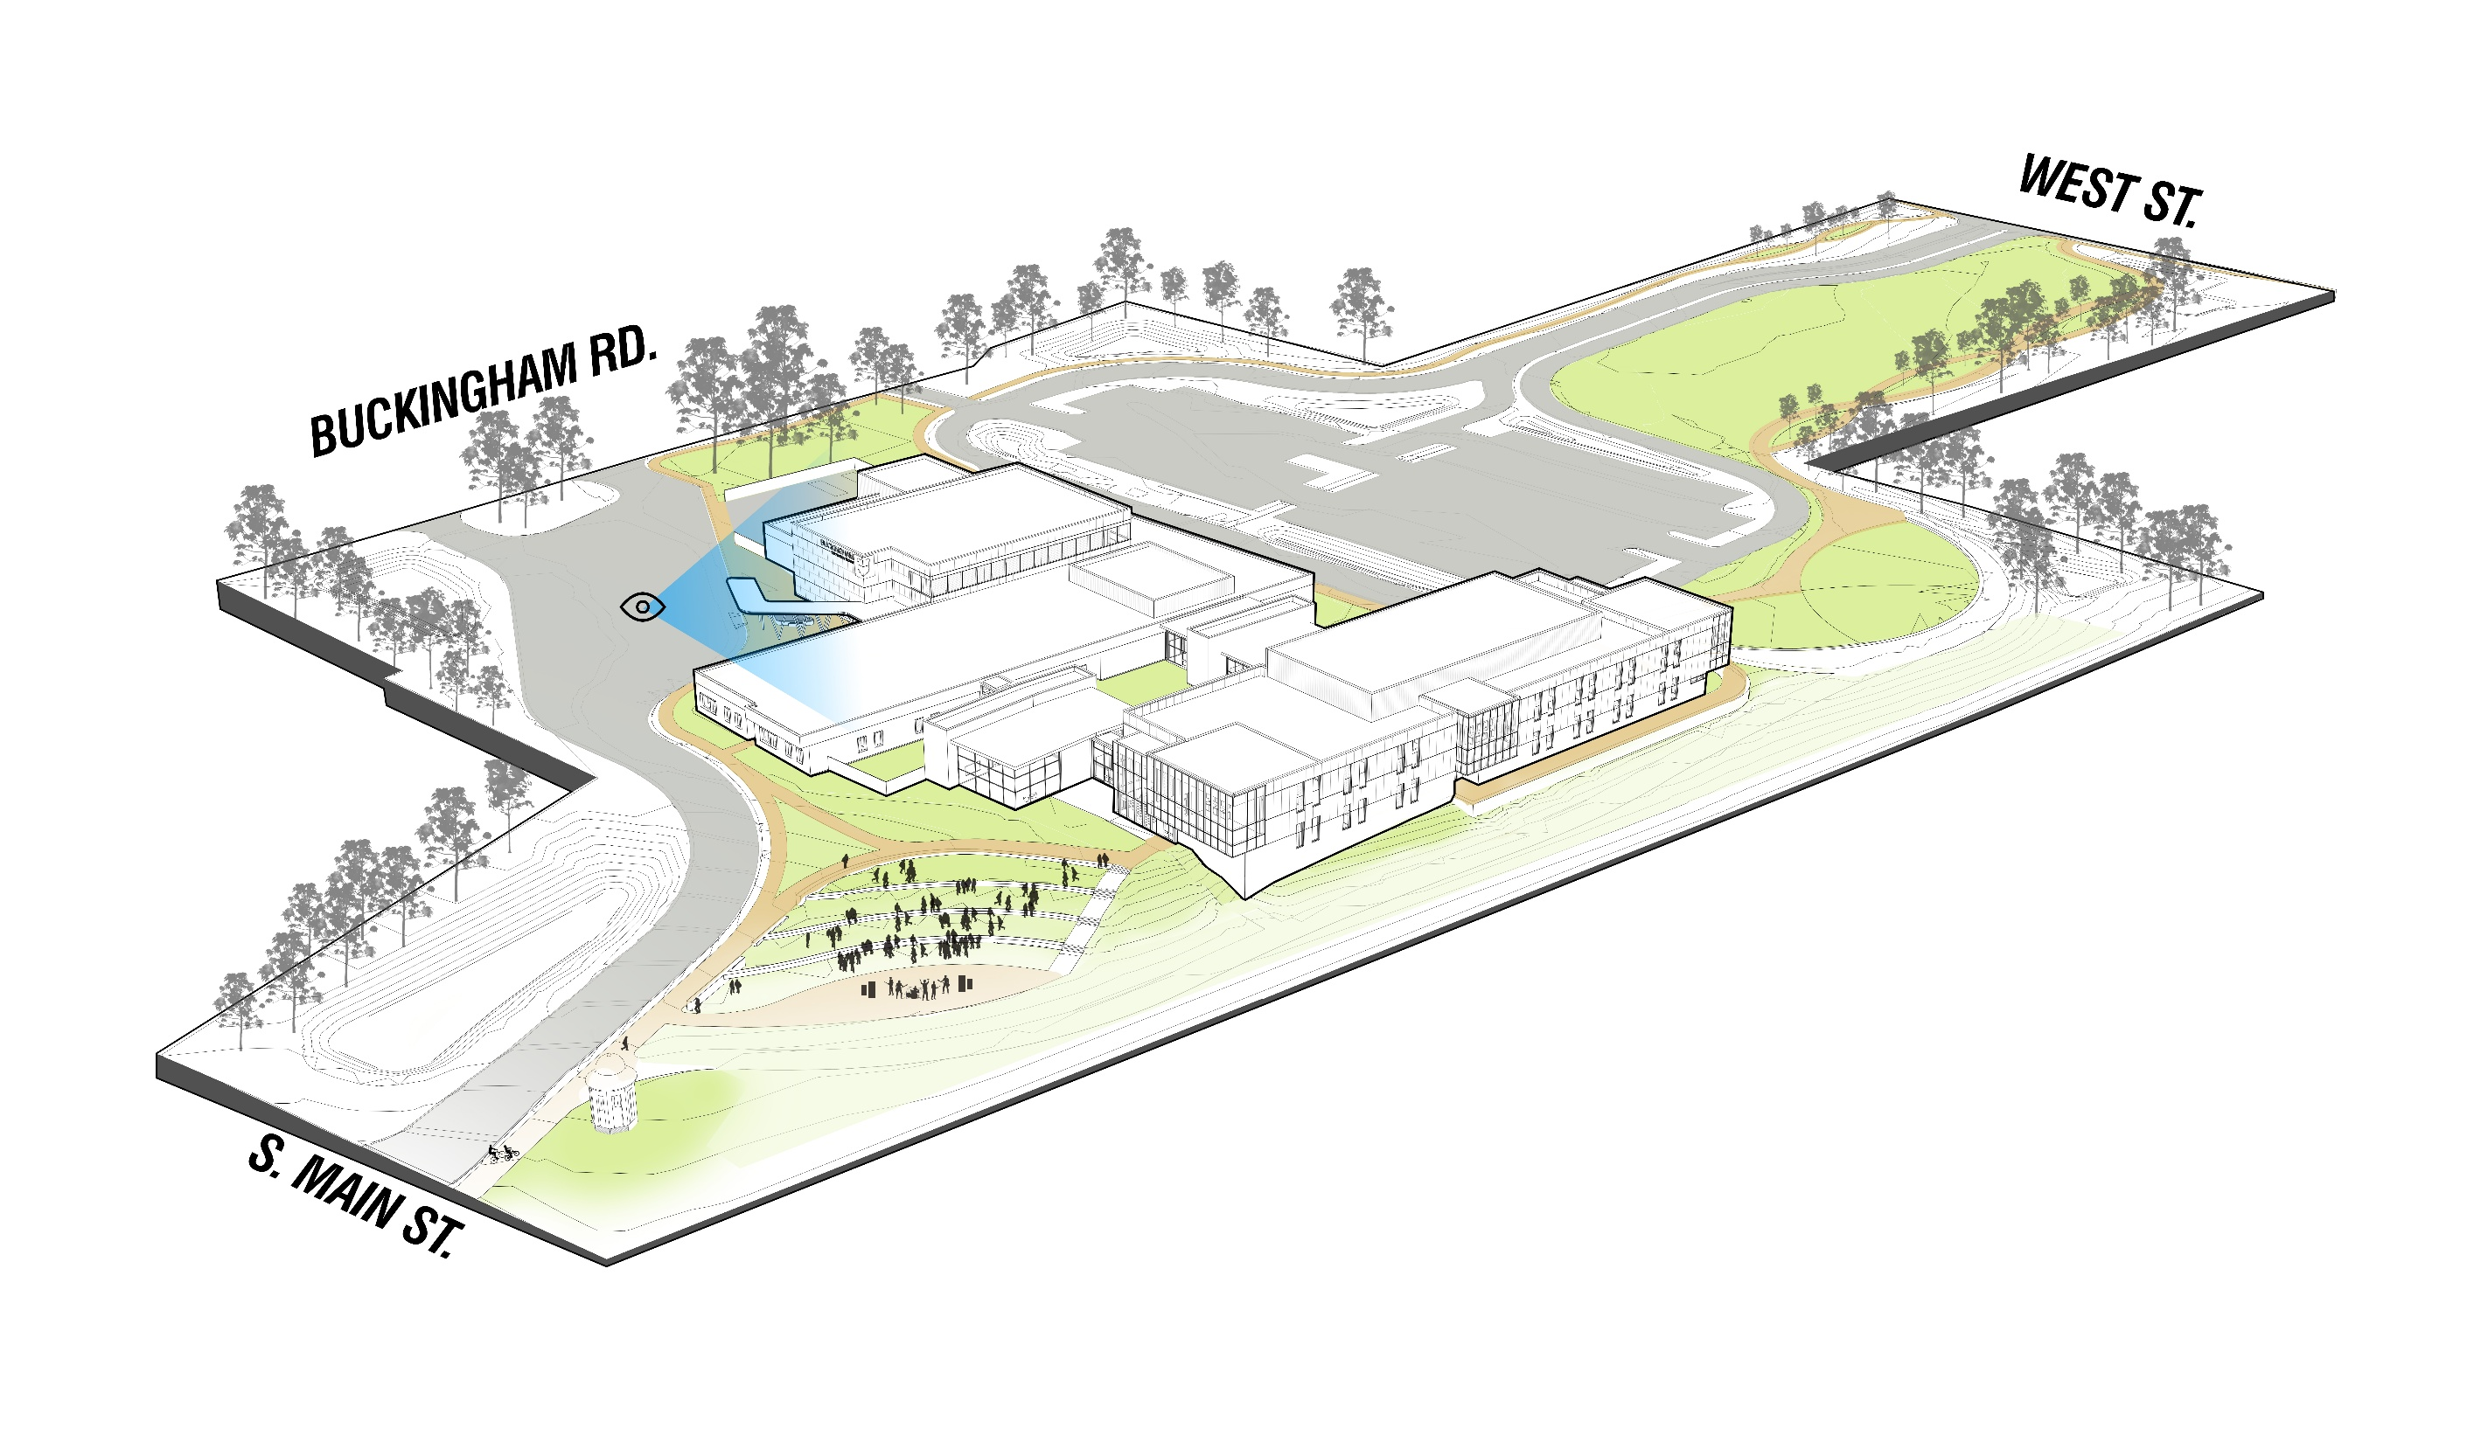
MAIN ST. – BUS DROP OFF CANOPY

Slide 37
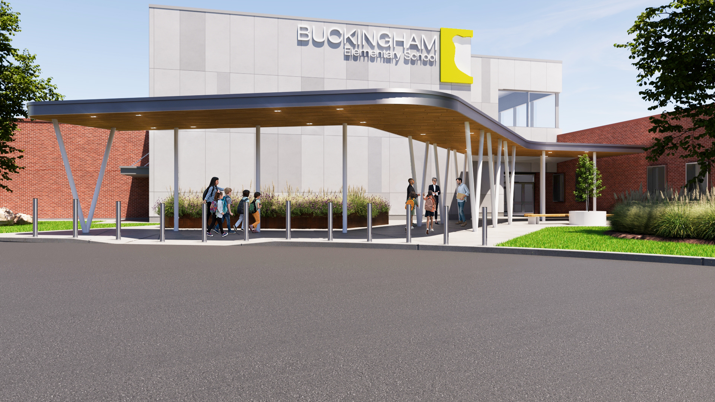
MAIN ST. – BUS DROP OFF

Slide 38
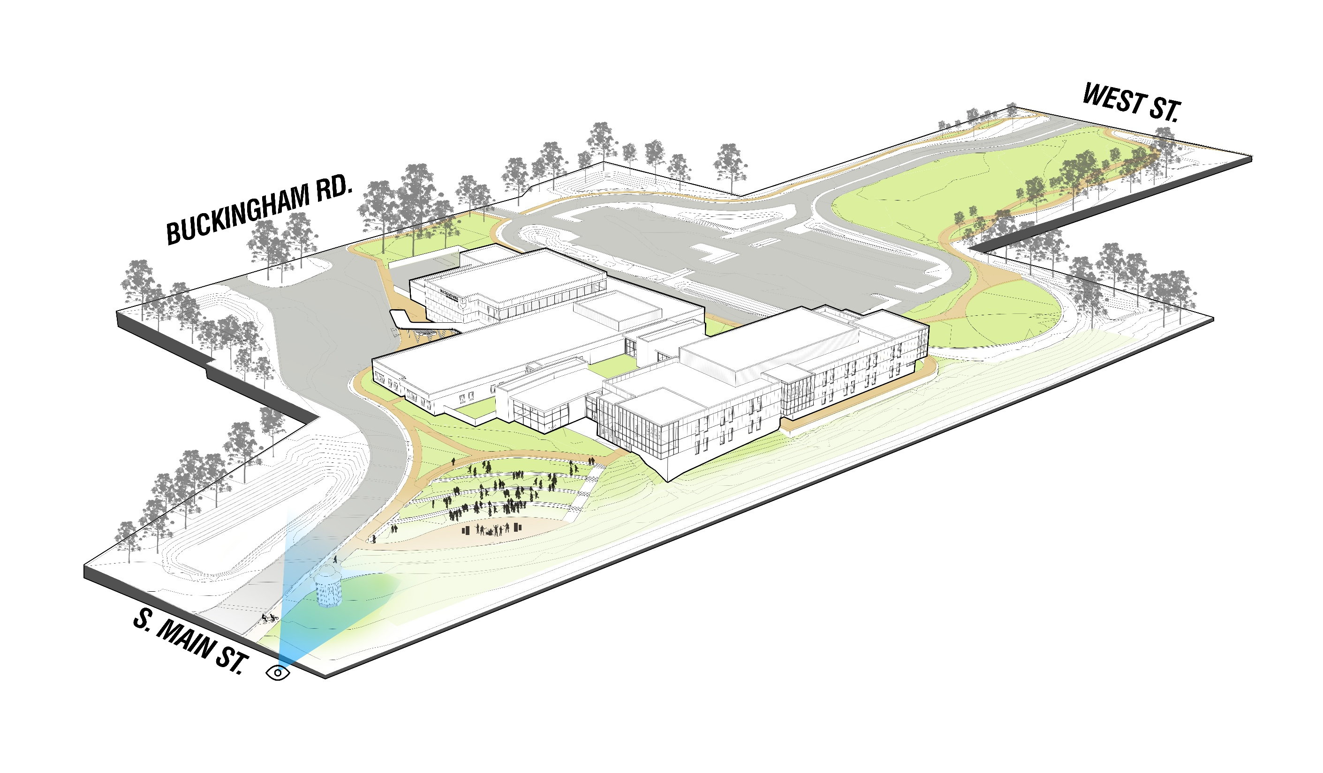
MEDIA CENTER / 2 STORY WING

Slide 39
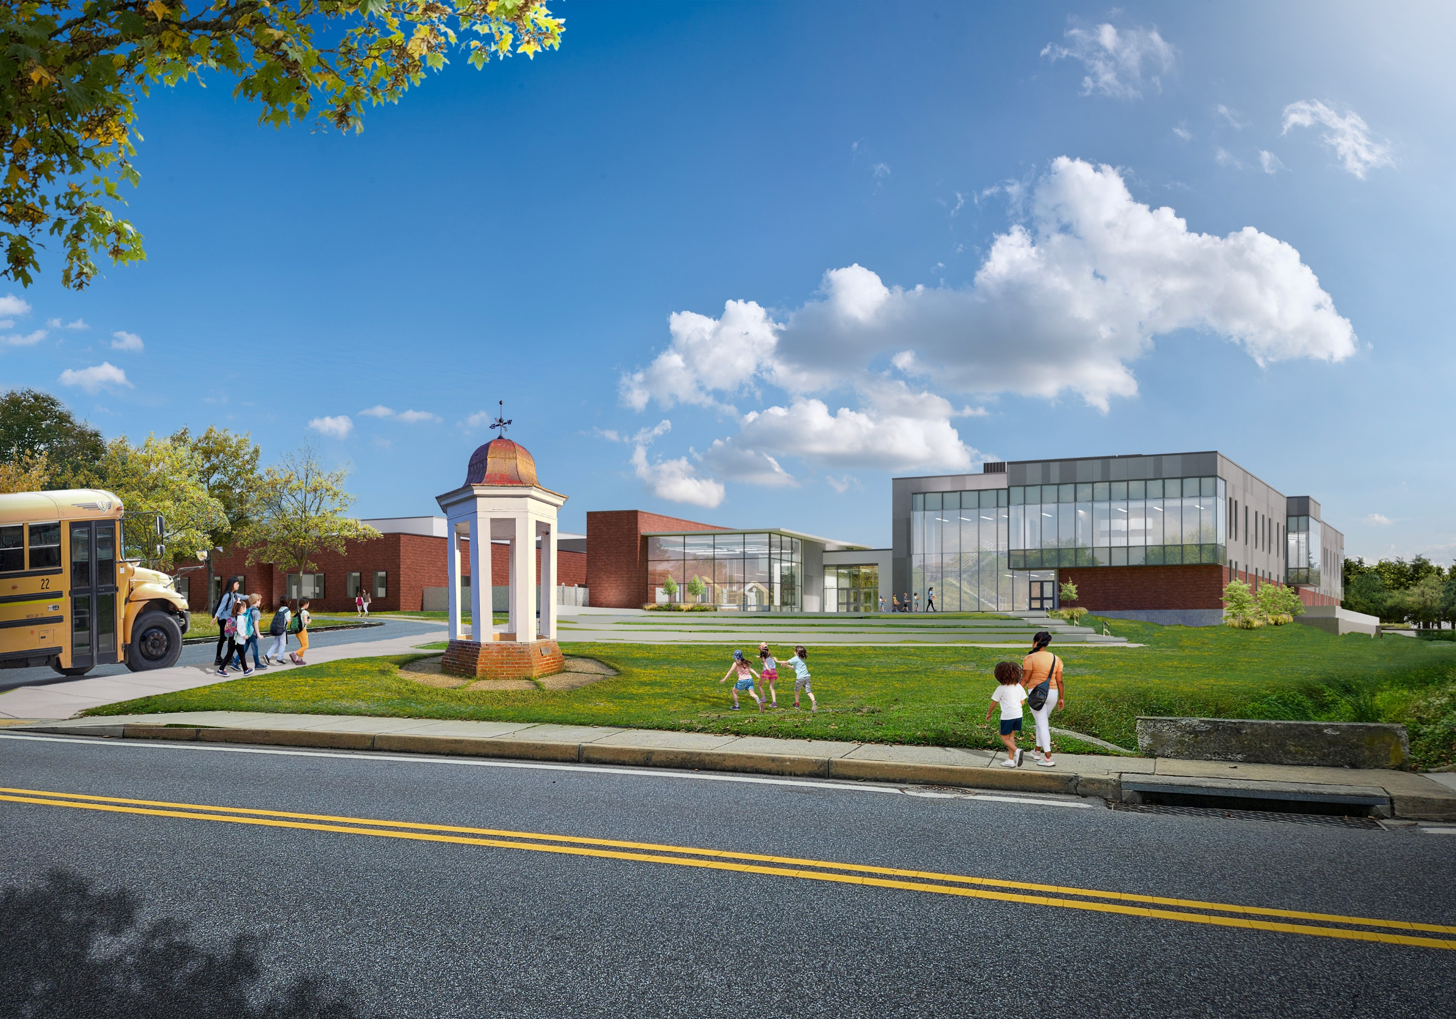
MEDIA CENTER / 2 STORY WING

Slide 40
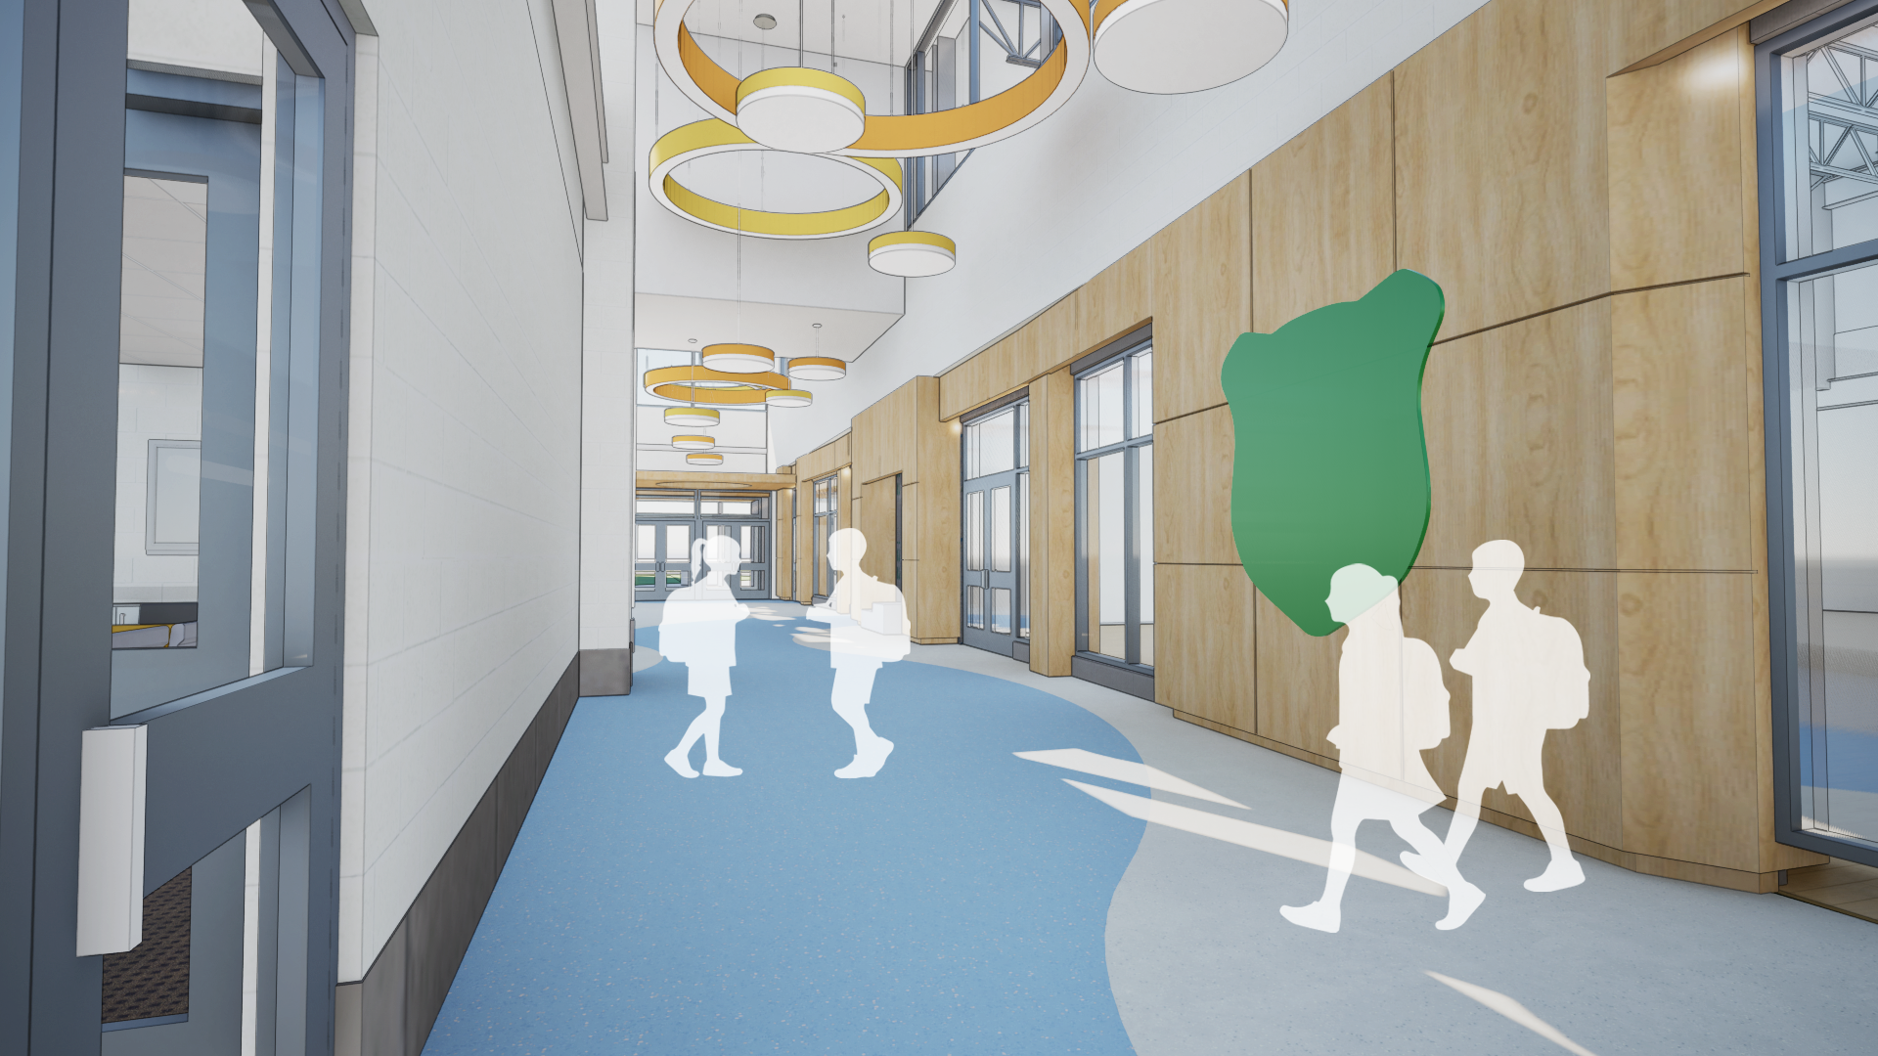
INTERIOR
FOCUS AREAS

Slide 41
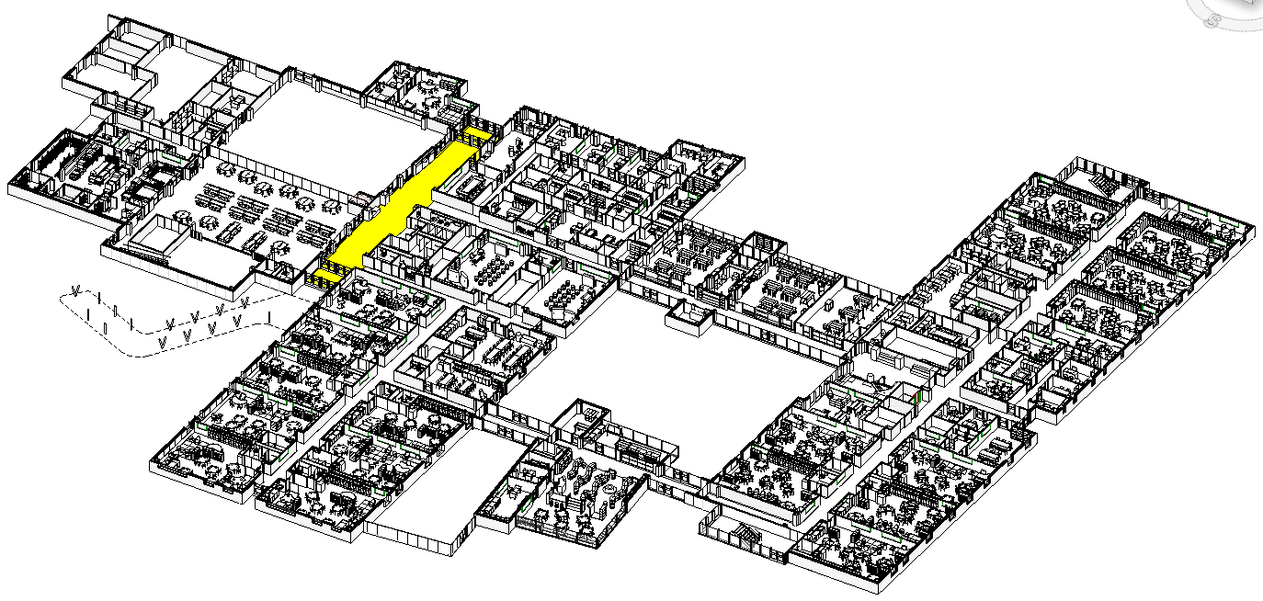
WELCOME – entry

Slide 42

WELCOME – entry from bus door

Slide 43

GATHER - cafetorium

Slide 44

GATHER - cafetorium from lobby

Slide 45

GATHER – cafetorium/gym from serving area

Slide 46




GROW – classrooms and corridors
MAIN STAIR
3rd
4th
2nd
1st
PRE-K 3 & 4
K

Slide 47

CPTED Principles
Crime Prevention Through Environmental Design
Multi-disciplinary approach of crime
prevention utilizing site and architectural
design, and the management of the
built and natural environments.
Focus on reducing opportunities
for crime, deterring offender decisions
preceding criminal acts and building a
sense of community to gain territorial
control, reduce crime and minimize
fear of crime.

Slide 48


Slide 49


Slide 50

ANIMATION

Slide 51






ENHANCED SAFETY MEASURES
PHYSICAL | TEMPORARY PARTITIONS, SAFETY BARRIERS, FENCES

Slide 52




ENHANCED SAFETY MEASURES
VISUALLY ENGAGING SAFETY BARRIERS

Slide 53

WEST STREET
CONSTRUCTION PHASE 1
TEMPORARY SITE IMPROVEMENTS
STARTING SPRING 2027
CONSTRUCTION
EXISTING SCHOOL, PARKING, CAR
DROP-OFF AND BUS CIRCLUATION REMAINS IN PLACE
WEST ST. IS WIDENED FOR NEW ENTRY
TEMPORARY PARKING AND ROADS CONSTRUCTED IN ADVANCE OF
FALL 2027 SCHOOL START
TEMPORARY UTILITY CONNECTIONS
TEMPORARY SWM, SEDIMENT & EROSION CONTROL
BUCKINGHAM RD.
MAIN STREET

Slide 54

WEST STREET
CONSTRUCTION PHASE 2
REPLACEMENT SCHOOL CONSTRUCTION
STARTING FALL 2027
EXISTING SCHOOL REMAINS IN PLACE
TEMPORARY PARKING AND CAR DROP-OFF LOOP VIA NEW WEST STREET ENTRANCE
NEW BUILDING UNDER CONSTRUCTION
TEMPORARY BUS DROP-OFF WITH NEW SIDEWALK ALONG BUCKINGHAM RD.
TEMPORARY SWM, SEDIMENT & EROSION CONTROL
BUCKINGHAM RD.
CONSTRUCTION
MAIN STREET

Slide 55


WEST STREET
CONSTRUCTION PHASE 3
REPLACEMENT SCHOOL COMPLETE
STARTING JUNE 2029
EXISTING SCHOOL DEMOLISHED
NEW SCHOOL COMPLETE FOR SUMMER 2029 TO OCCUPY BY FALL
NEW BUS LOOP AND CAR DROP-OFF LOOP COMPLETE
TEMPORARY PARKING LOT REMAINS AS FINAL PARKING LOT (UNDER EXISTING BUILDING) IS COMPLETED
TEMPORARY SWM, SEDIMENT & EROSION CONTROL
BUCKINGHAM RD.
CONSTRUCTION
MAIN STREET

Slide 56

WEST STREET
CONSTRUCTION PHASE 4
FINAL SITE COMPLETION
END OF 2029
CONSTRUCTION
FINAL SITE FIELDS AND PARKING ARE COMPLETED
FINAL SWM COMPLETED
FINAL PARKING LOT COMPLETED
CONTRACTOR DEMOBILIZED
BUCKINGHAM RD.
MAIN STREET

