Slide 1

TOWN OF BERLIN, MARYLAND · RECONNECTING COMMUNITIES & NEIGHBORHOODS
BERLIN
BEYOND THE BRIDGE
A pedestrian bridge over US 113 was the original idea. The feasibility study and extensive community engagement point somewhere else: slower speeds, safer crossings at all three intersections, and a shared-use path along the highway itself — connecting the hospital, grocery store, schools, library, Main Street, and the neighborhoods on both sides of the Highway.
1.7 mi
3
2
515
~20,000
of US 113 through town
studied crossings
existing marked crosswalk
collisions since 2000
vehicles / day

Slide 2
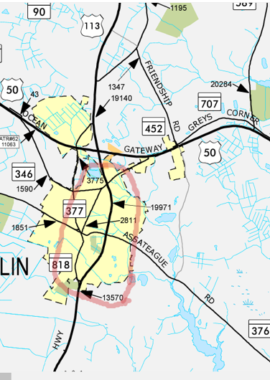
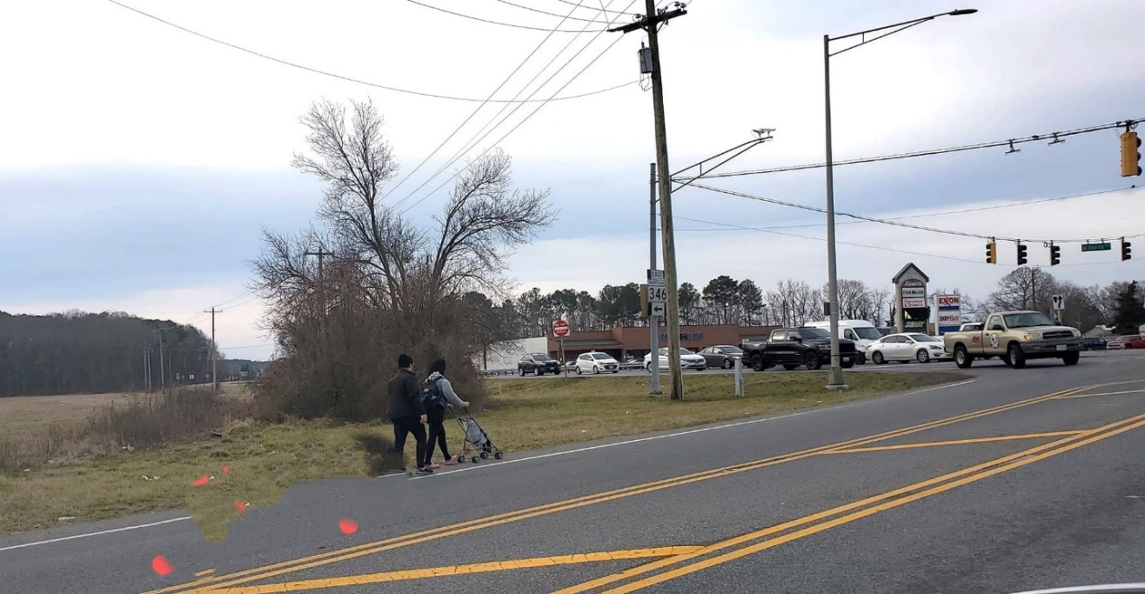
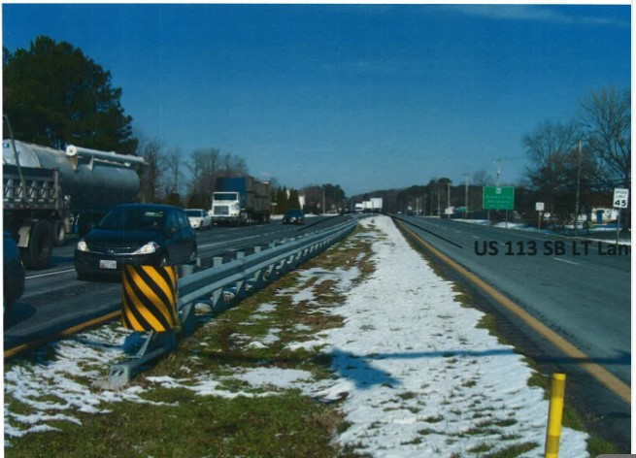
BACKGROUND When US Highway 113, also known as Worcester Highway, was constructed in the early 1930s through the middle of Berlin, it concretely divided the population east and west, “creating a permanent symbol of racial divide, leaving an indelible impact on long term members of our east Berlin community.” (DJ Lockwood).
As it did across the country, the construction of the US Highway system contributed to the residential concentration of race and poverty in Berlin. The once thriving businesses and community schools of the east side are now gone and discriminatory planning processes subsequently resulted in placement of the county landfill on the east side of Berlin on Flower Street, in a historic African American neighborhood, also known as Briddletown, where free blacks or ex-slaves acquired properties after the Civil War.
Guided by the data and the community engagement process in Phase One of the Reconnecting Communities and Neighborhood Grant, The Town of Berlin used context-driven decision-making to identify, evaluate, and prioritize solutions that address and mitigate the negative impacts of the Route 113 barrier and provide connectivity to the Worcester County Greenways and Trails network that is being planned beyond town limits. Working with the owner/operators of the road, Maryland Department of Transportation - State Highway Administration (MDOT-SHA) and federally qualified contractor(s) to evaluate feasibility of identified options for safe crossing for pedestrians, bicycles, and those using other mobility devices, while maintaining the capacity to handle existing transportation needs of the roadway. Project deliverables include preliminary plans with pre-development design for additional or improved bike and pedestrian crossings of US 113 and connections to existing and planned shared use trails and cost estimates and identification of funding options that would prepare the town to apply for capital construction funds for active transportation in future years.
US 113 runs through Berlin carrying heavy truck traffic at 45mph+ making it unsafe for pedestrians and bikes to cross from east where most residents without vehicles live to the west where most amenities and services are located
Grandma, Mom & baby walking from Victoria Estate Apartment to Food Lion will have to cross US 113 without a sidewalk or crosswalk

Slide 3
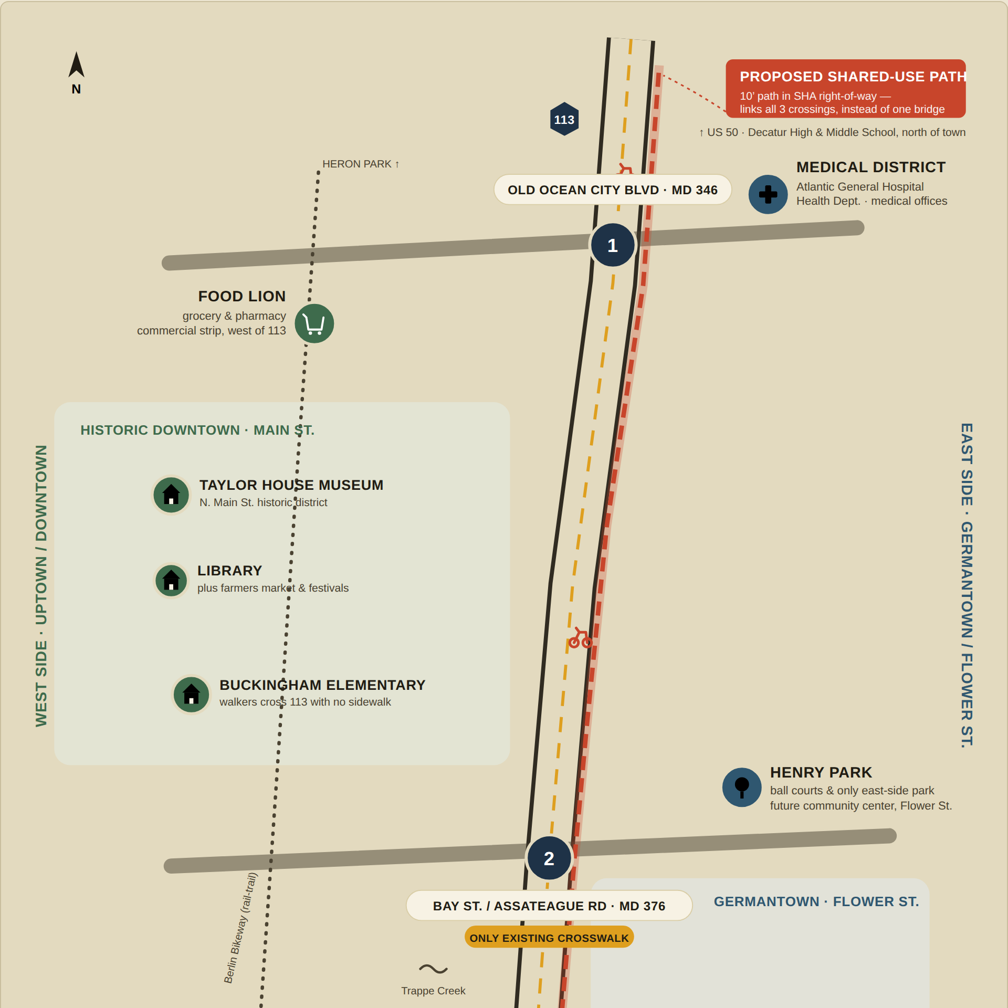
THE CORRIDOR · PART 1 OF 2
Old Ocean City Blvd. to Bay Street
US 113 runs the length of town as a four-lane divide. At the north end, Old Ocean City Blvd. (MD 346) sits beside the town's Medical District — Atlantic General Hospital, the Health Department, and medical offices — with Food Lion and the commercial strip just across the highway.
Heading south, the historic downtown core — the Taylor House Museum, the library, and Buckingham Elementary — sits entirely on the west side, with no sidewalk for anyone walking in from the east.
The coral line is the proposed shared-use path: a continuous route in the state's existing right-of-way, running north–south alongside the highway instead of stopping at one bridge.
Schematic, not to scale. Source: Town of Berlin Pedestrian/Bicycle Bridge Feasibility Study, July 2026.

Slide 4
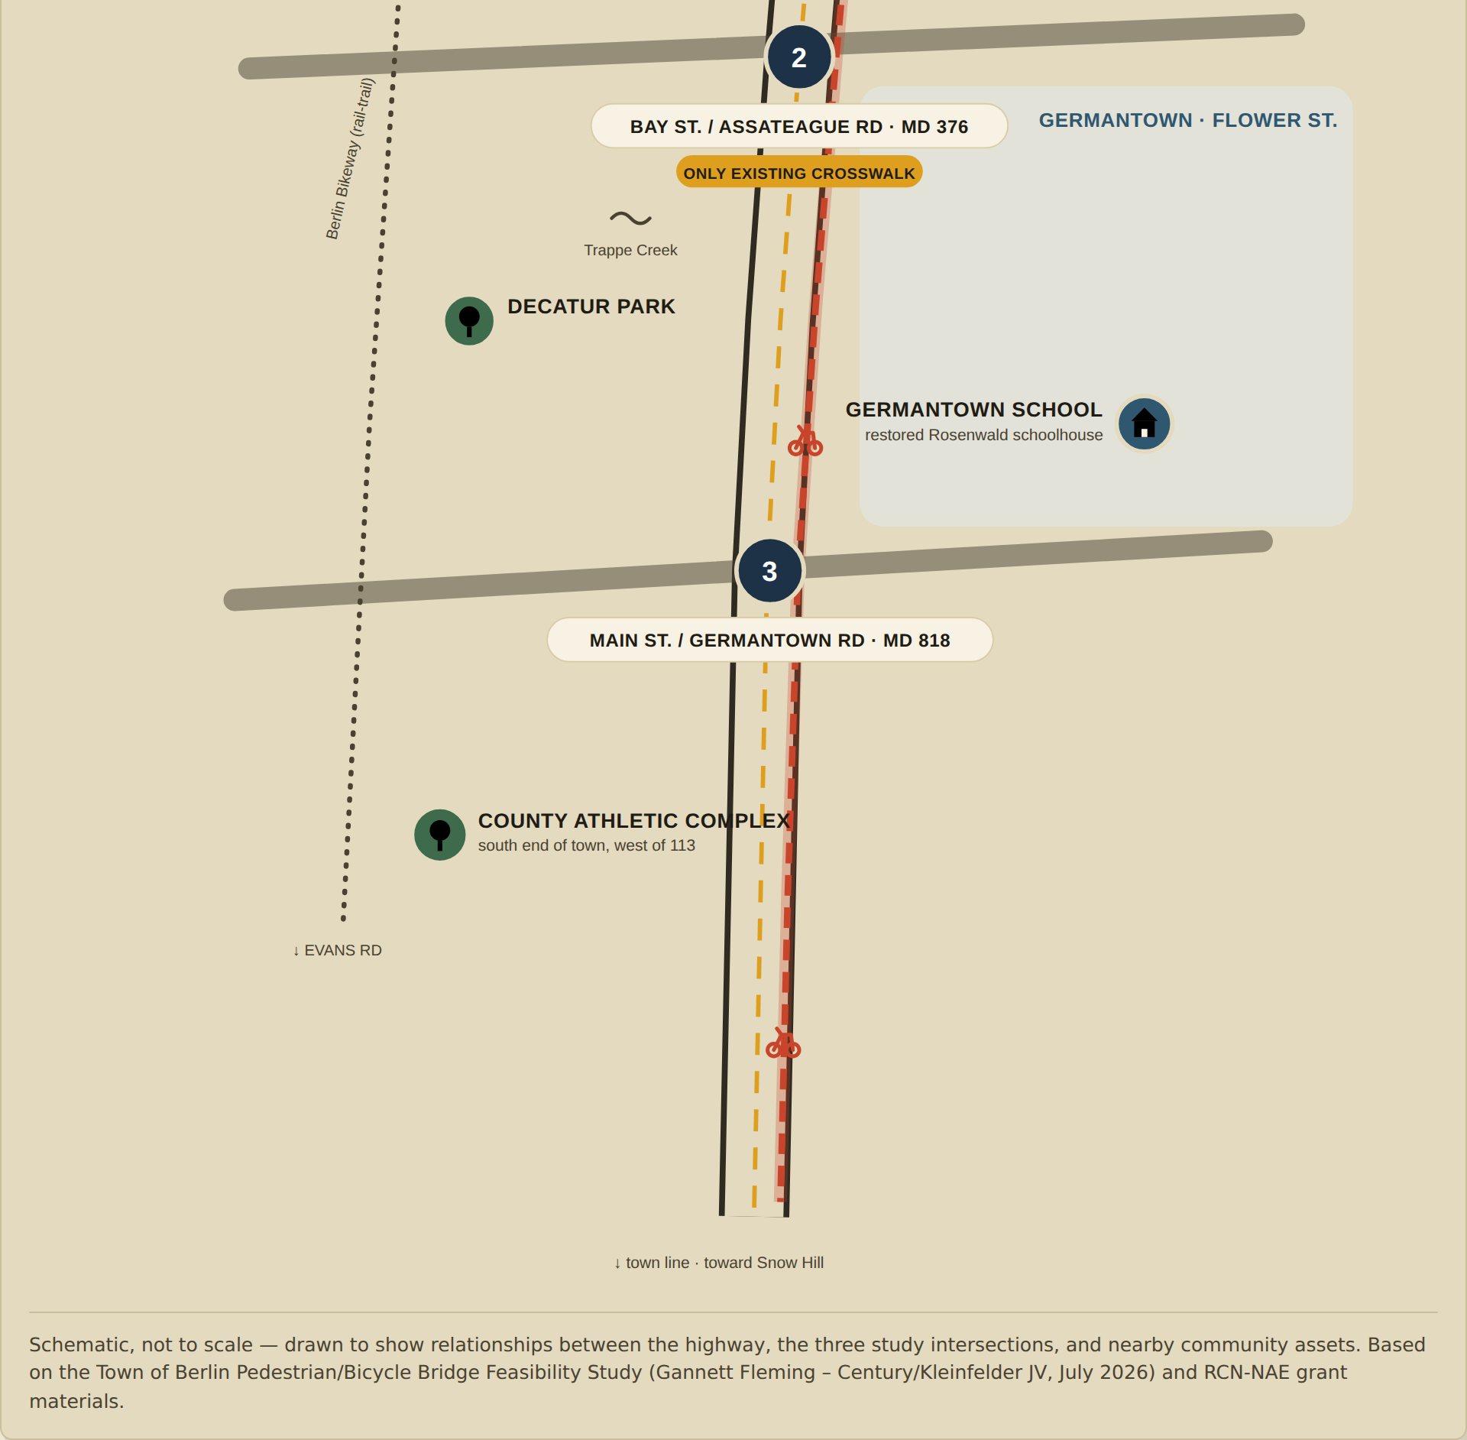
THE CORRIDOR · PART 2 OF 2
Bay Street to Germantown Road
Bay Street / Assateague Rd. (MD 376) has the only existing marked crosswalk on US 113 today — and, per the feasibility study, the best-fit technical site for a bridge. Henry Park and the future community center sit just east, along Flower Street.
Further south, Main St. / Germantown Rd. (MD 818) marks the edge of town, near the Germantown School Community Heritage Center — a restored Rosenwald schoolhouse — and the County Athletic Complex.
The shared-use path continues through both crossings, so residents on either side reach downtown, the park, and the schools without waiting on a single bridge location.
Schematic, not to scale. Source: Town of Berlin Pedestrian/Bicycle Bridge Feasibility Study, July 2026.

Slide 5
WHY NOT THE BRIDGE
One bridge vs. a path that reaches everyone
The feasibility study priced an elevated bridge at each of the three crossings. All three came back the same way: technically buildable, extremely expensive, and not what residents said they’d actually use.
Pedestrian & Bicycle Bridge
1 CROSSING
Speed Limit + Crossings + Path
ALL 3 CROSSINGS
$18–24M
$50K–1M
estimated cost, per single crossing studied
per at-grade improvement (RRFB, signal, sidewalk)
Long ramps: ADA-compliant 5% grade plus highway clearance meant ramps residents called impractical
Reaches the whole corridor: sidewalks, RRFBs and signals at all three intersections
Serves one point: only the crossing it’s built at, not the other two
35 mph corridor: a lower posted speed makes every crossing safer, everywhere
Low demand: most survey respondents said they’d rarely or never use one
What residents asked for: the top preference in both engagement sessions and the survey
Longer road to funding: full NEPA review before construction could begin
Shorter road to funding: minimal wetlands / ROW impact vs. a structure over the highway

Slide 6
WHERE THIS STANDS
Moving Berlin forward, in three steps
The Town has already secured funding to act on the study’s short-term recommendations. A full shared-use path along 113 needs further study and right-of-way work with SHA — but the first moves are underway now.
01
02
03
Design the shared-use path
Lower the speed limit
Improve all three crossings
Berlin has prepared a SOW for Preliminary Design (30%): US 113 Shared-Use Path & Intersection Improvements
The Town of Berlin seeks a preliminary concept design of a Shared Use Path on US 113 between Old Ocean City Boulevard and Germantown Road, with Intersection Improvements along US 113, at MD 346 (Old Ocean City Boulevard), MD 376 (Bay Street) and MD 818 (South Main Street/Germantown Road).
Berlin is working with District One MDOT’s Office of Traffic Safety to reduce speeds on US 113 through Berlin to 35 mph — the change that makes every other improvement safer to build.
Plan for pedestrian signals, crosswalks, sidewalks and ADA landings at Old Ocean City Blvd., Bay St./Assateague Rd., and Main St./Germantown Rd. — make sure to review the Town’s role with future Developers at midblock crossings at Franklin Ave. and Tripoli Street
Funded by a $643,000 repurposed MDOT federal earmark, matched by $113,000 in Worcester County Rail & Trail funds and $104,000 already in Berlin’s municipal budget — covering the minimum required 20% ($128,000) local match.

Slide 7
LEARN MORE & SHARE FEEDBACK
This is a conversation about connection.
The shared-use path still needs further study and right-of-way coordination with the State Highway Administration. Town staff want to hear from residents on both sides of 113 as that work continues.
Project page: berlinmd.gov/reconnecting-communities-and-neighborhoods
Contact: MayorZack@berlinmd.gov
SOURCES
Town of Berlin Pedestrian/Bicycle Bridge Feasibility Study & Executive Summary (Gannett Fleming–Century/Kleinfelder JV for MDOT SHA, July 2026) · Reconnecting Communities & Neighborhoods – Neighborhood Access & Equity grant narrative and MDOT project rack card, Town of Berlin, Maryland.
TOWN OF BERLIN, MARYLAND · EST. 1868

